Slide 1
CSE 326
Information system design
1705001 – Kowshic Roy
1705002 – Sheikh Azizul Hakim
1705003 – Mahdi Hasnat Siyam
1705008 – Sheikh Saifur Rahman Jony
1705015 – Zaber Ibn Abdul Hakim
1705024 – Khandokar Md. Rahat Hossain

Slide 2
How are you?
A Mental Health Screening Tool

Slide 3
HOME

Slide 4
Home
Visitor
Patient
Psychiatrist

Slide 5
Home
Visitor
Patient
Psychiatrist

Slide 6
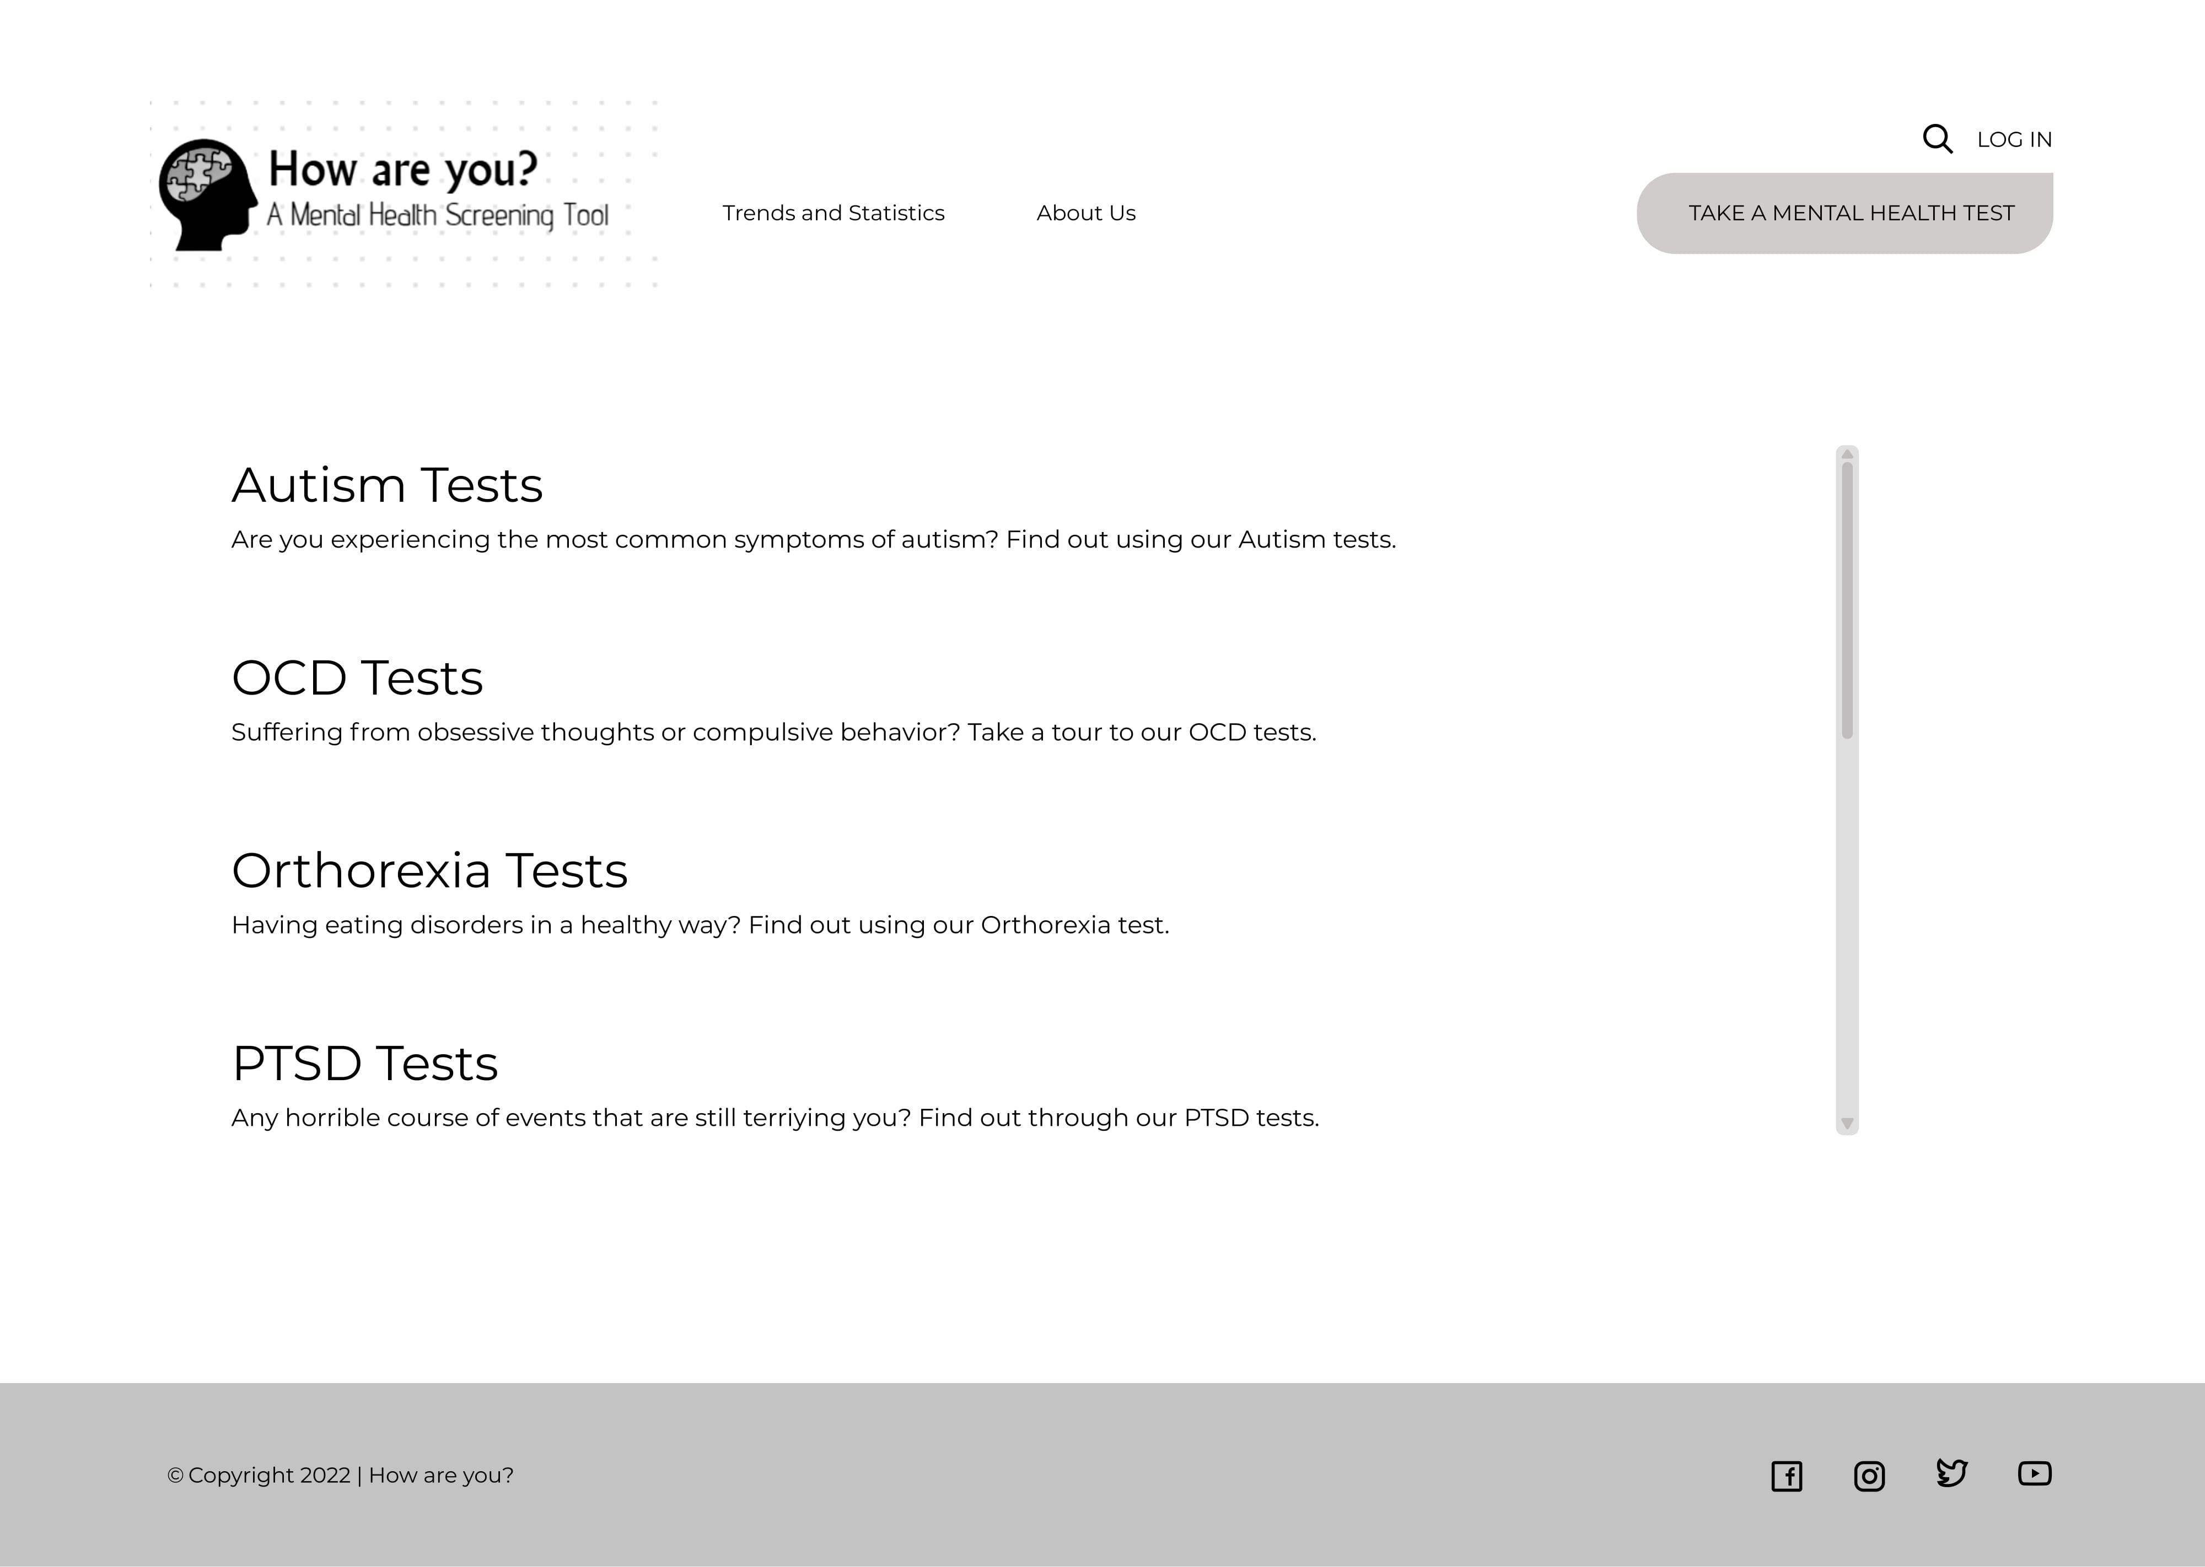

Slide 7
STATISTICS

Slide 8
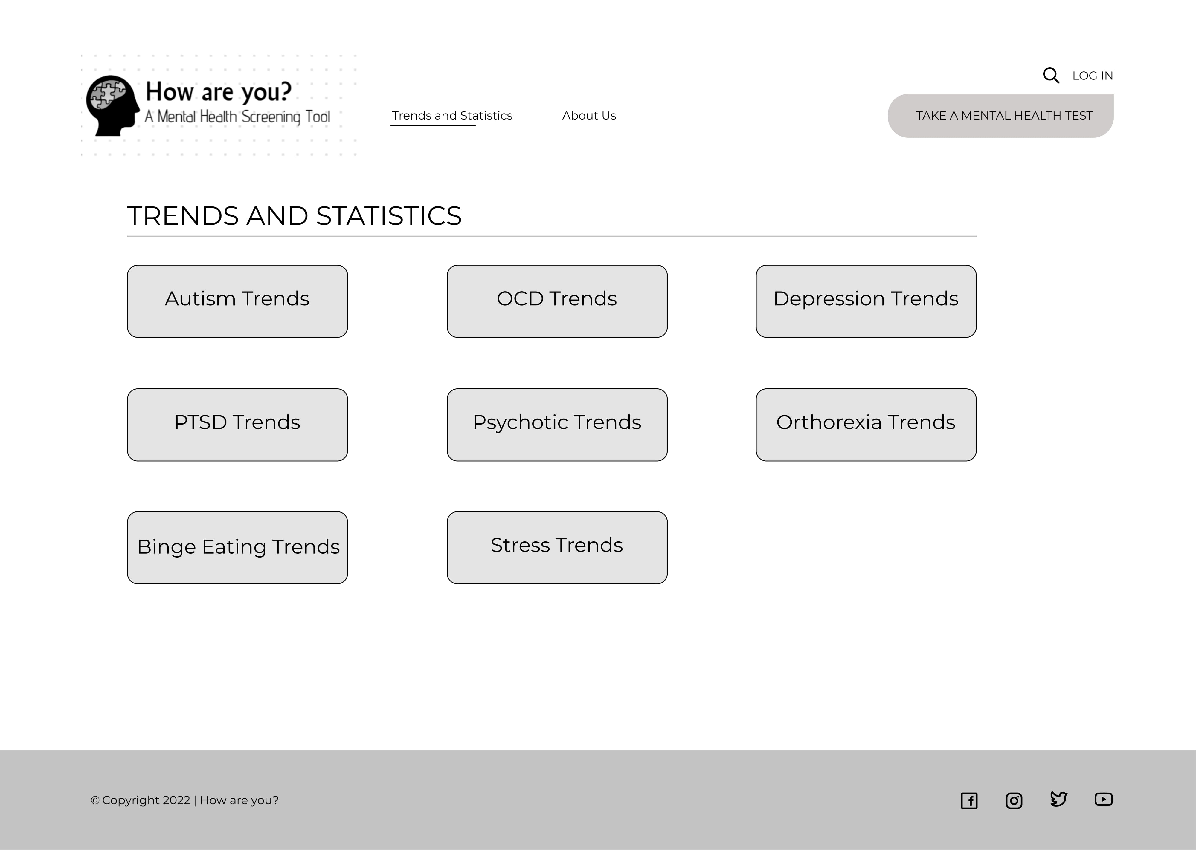

Slide 9
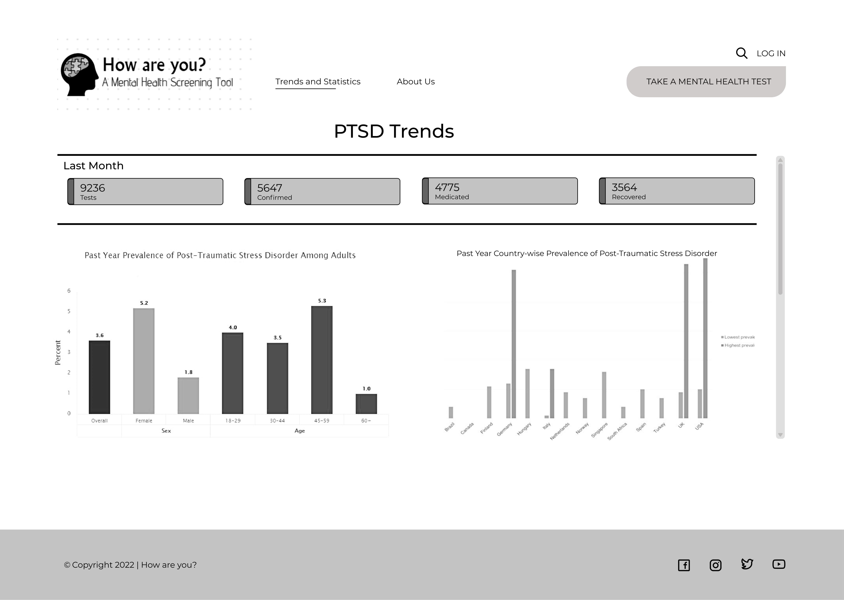

Slide 10
LOGIN

Slide 11
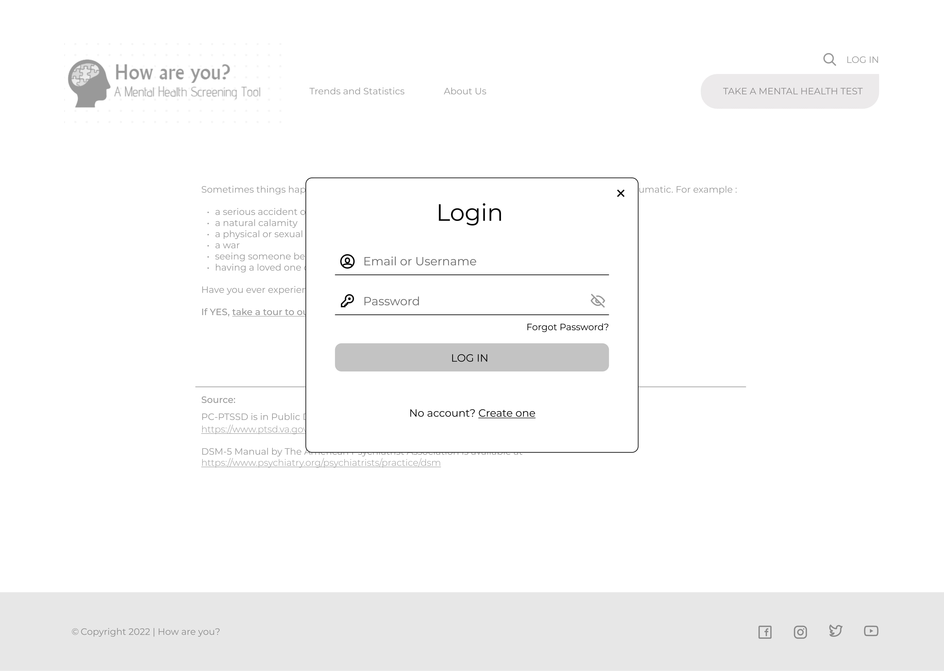

Slide 12
SIGNUP

Slide 13
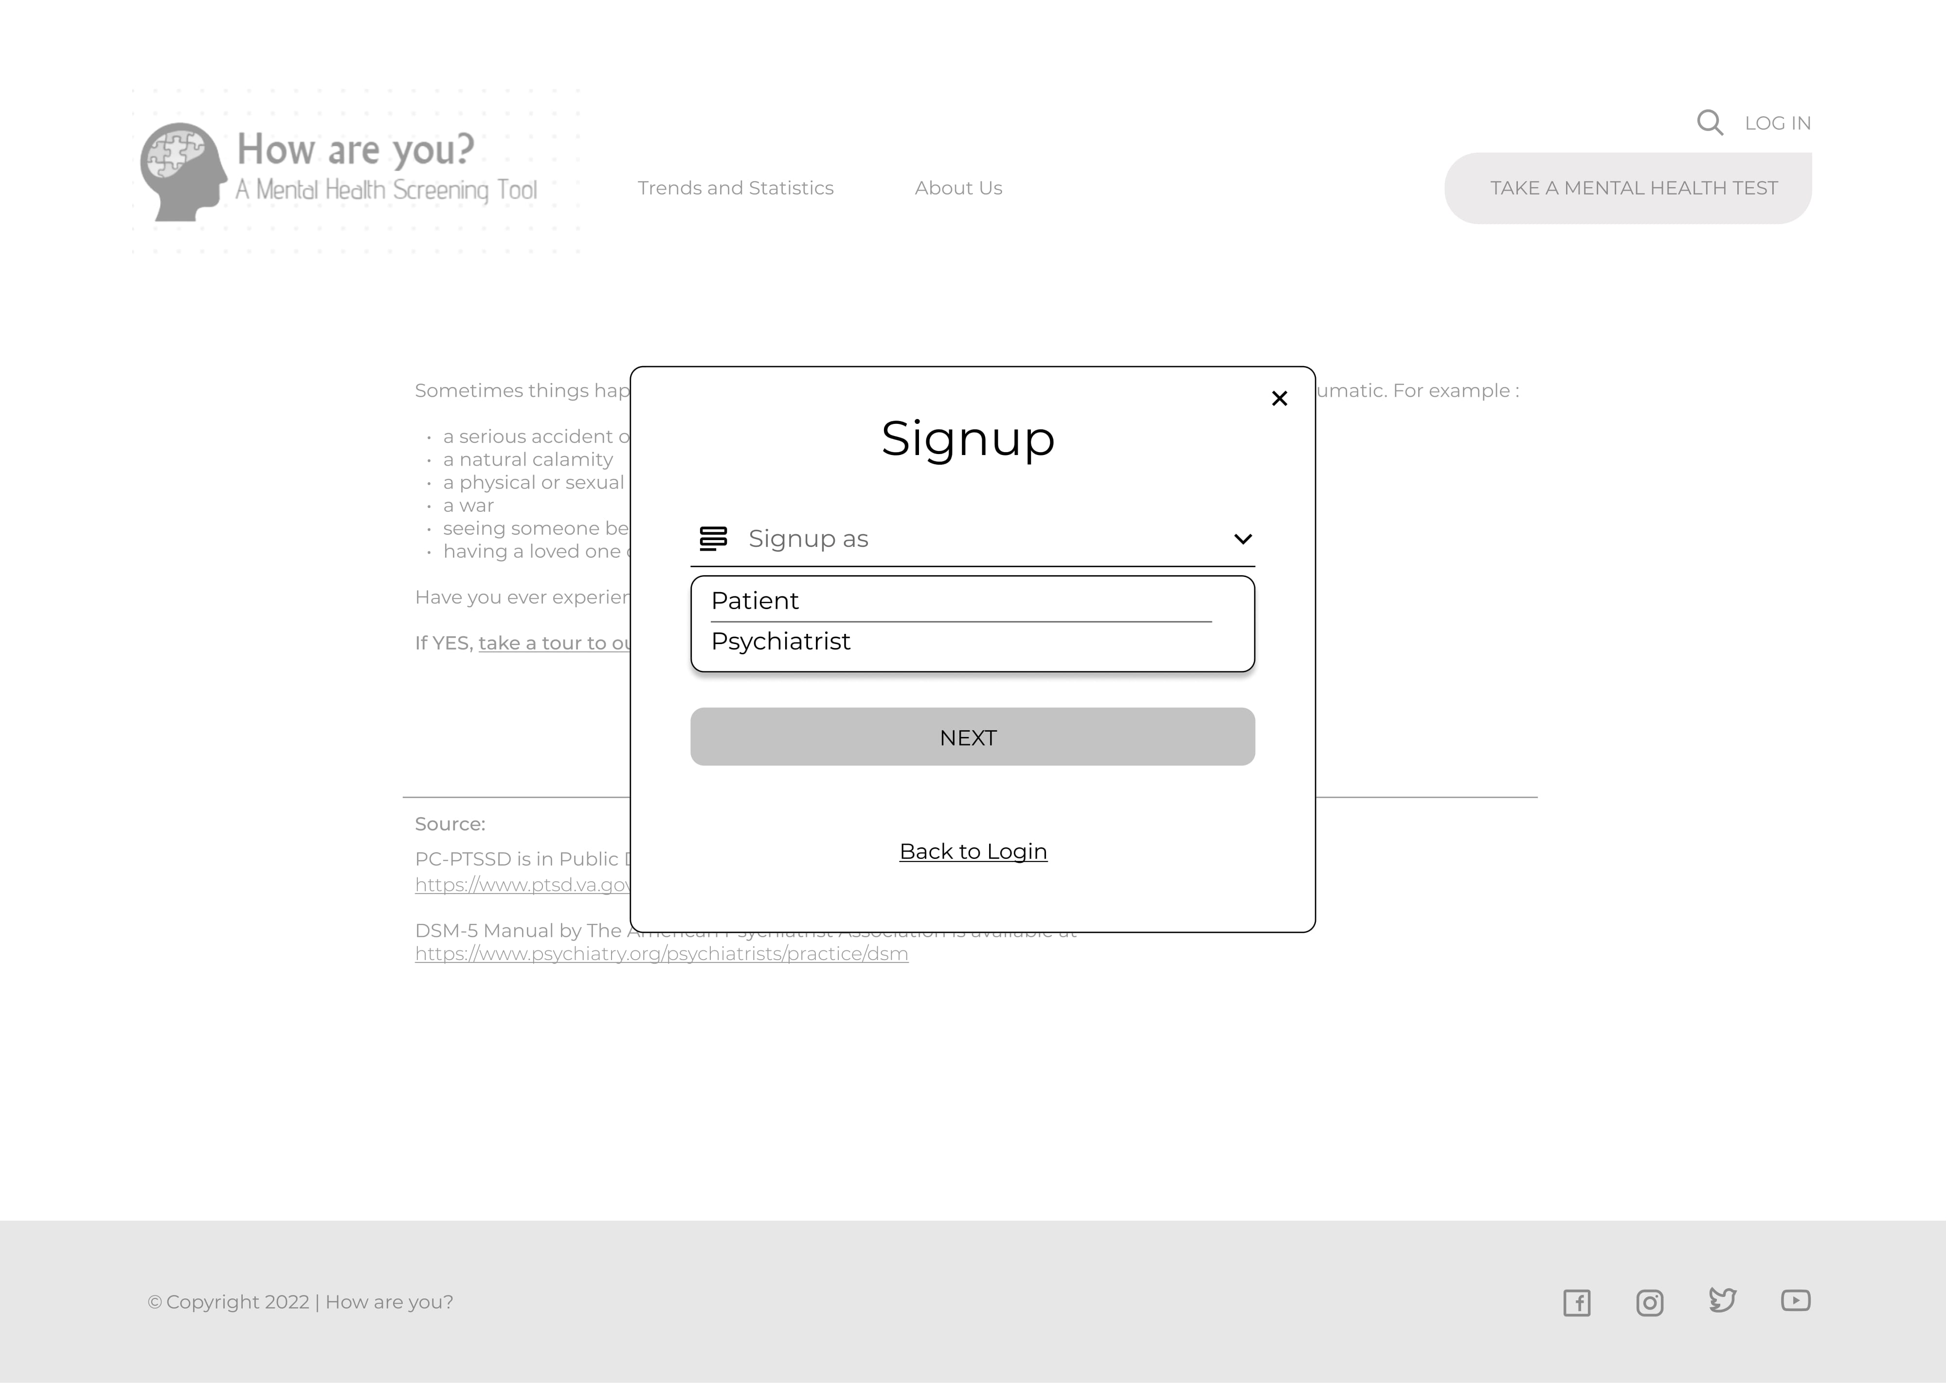

Slide 14
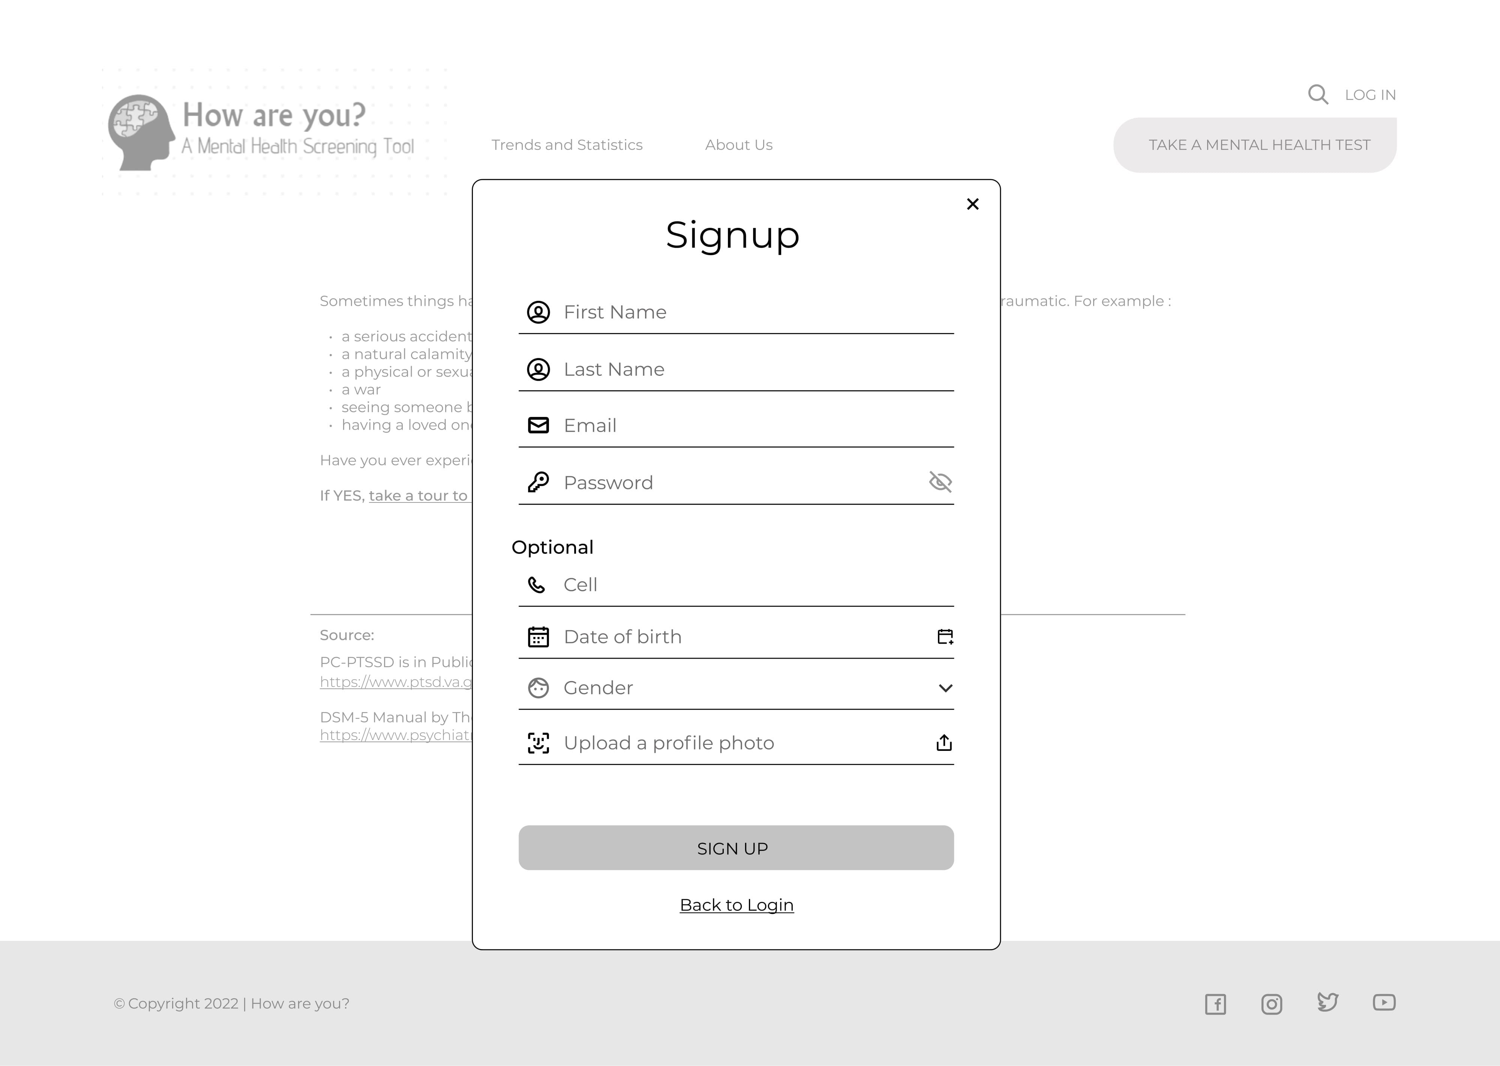

Slide 15
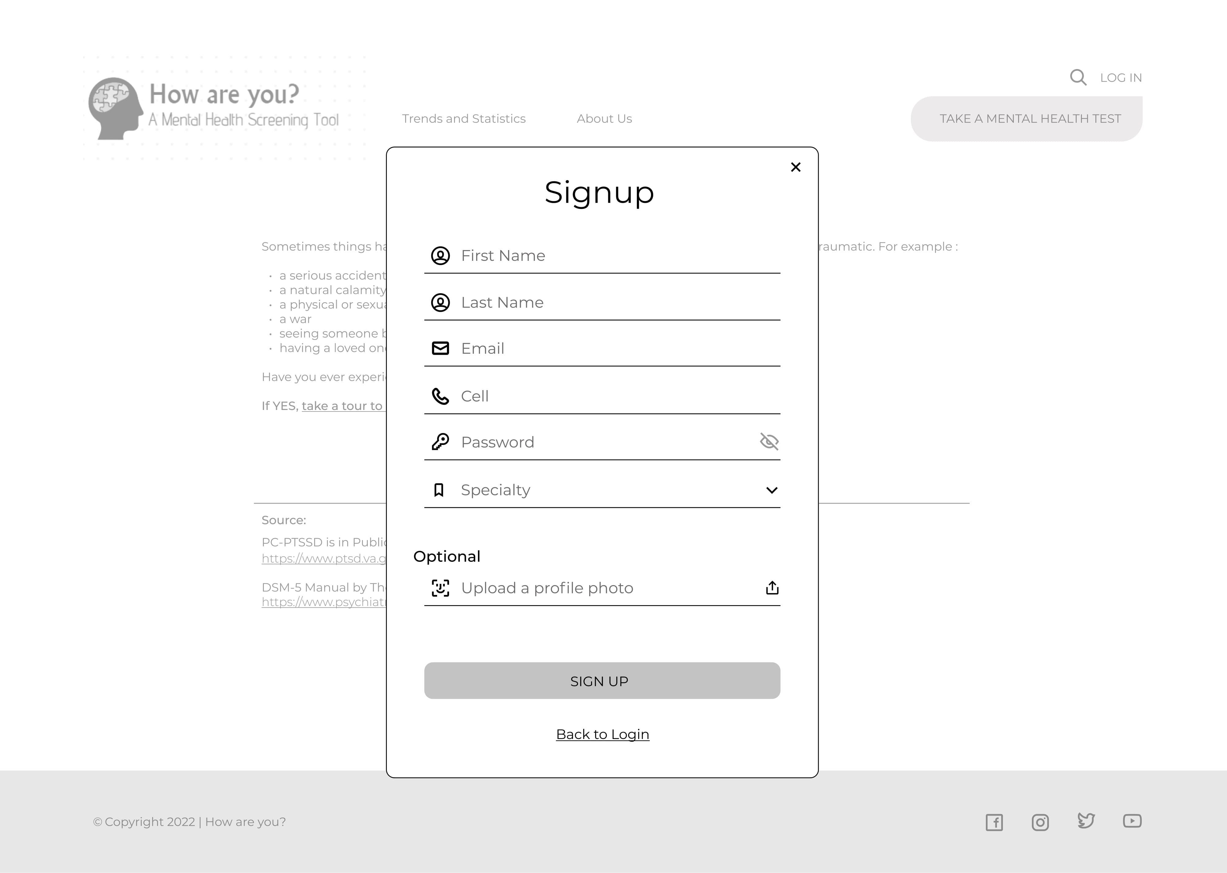

Slide 16
Home
Visitor
Patient
Psychiatrist

Slide 17
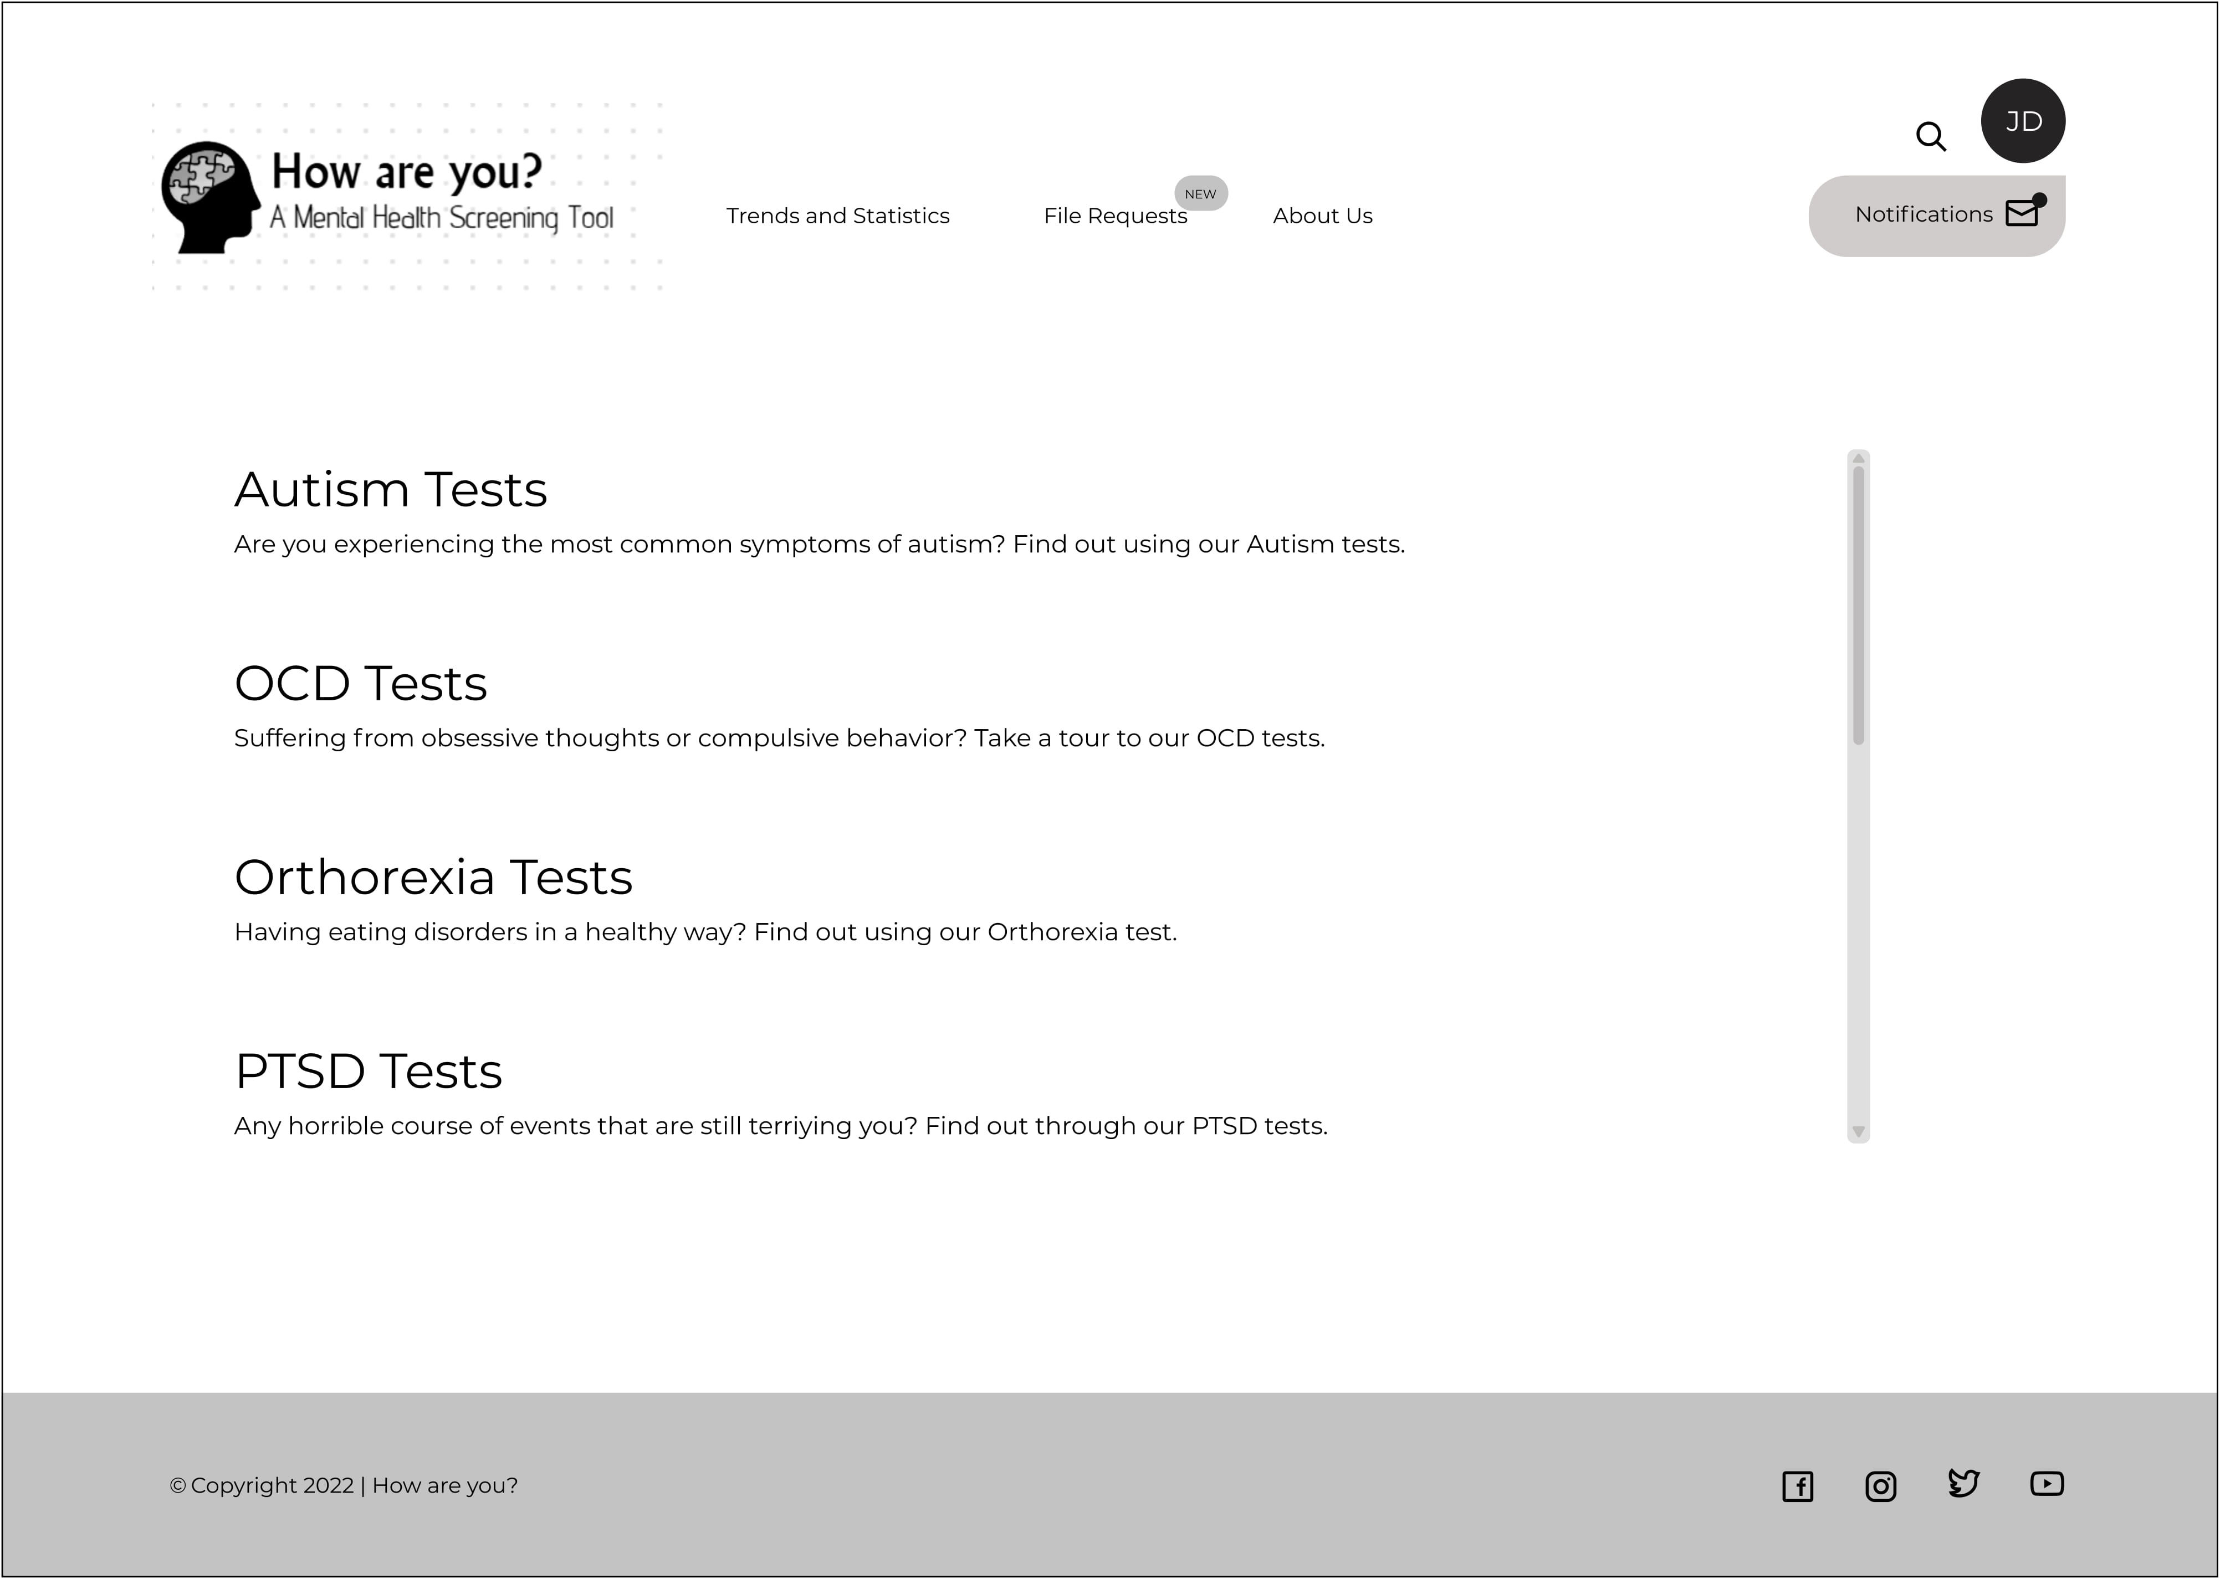

Slide 18
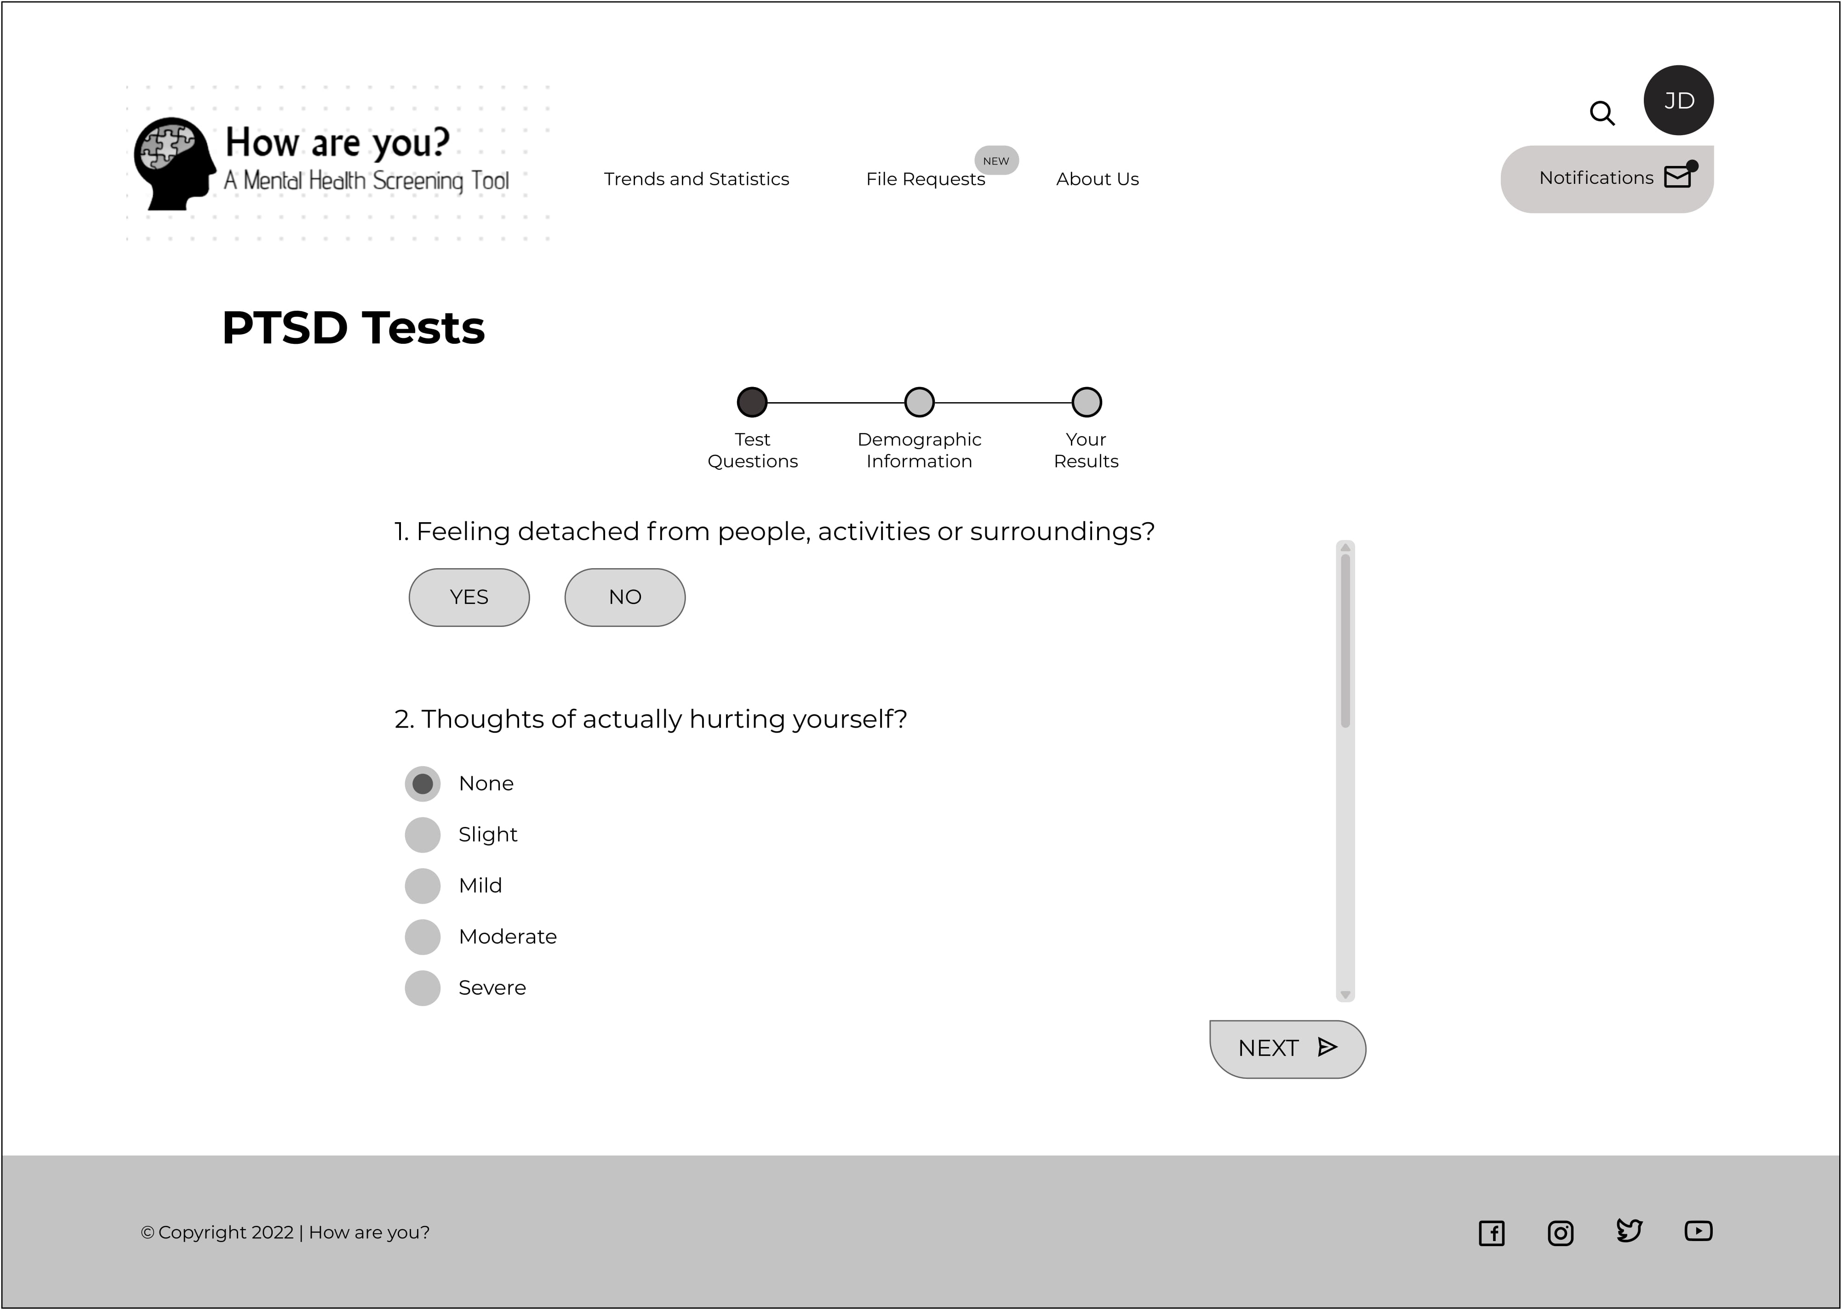

Slide 19
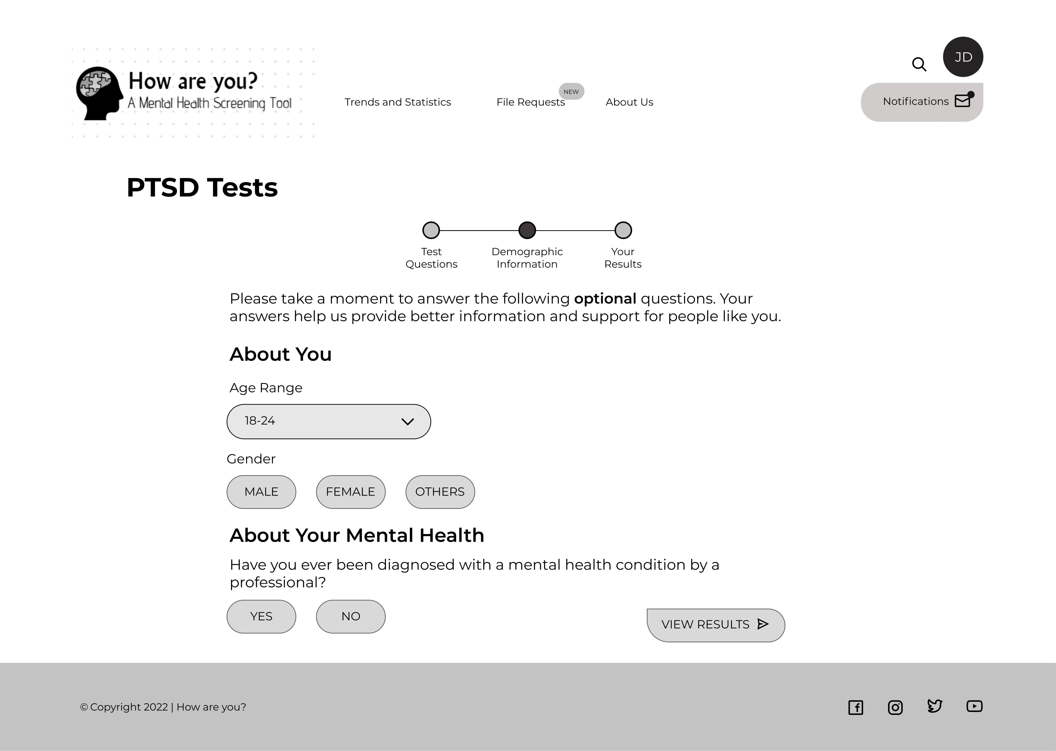

Slide 20
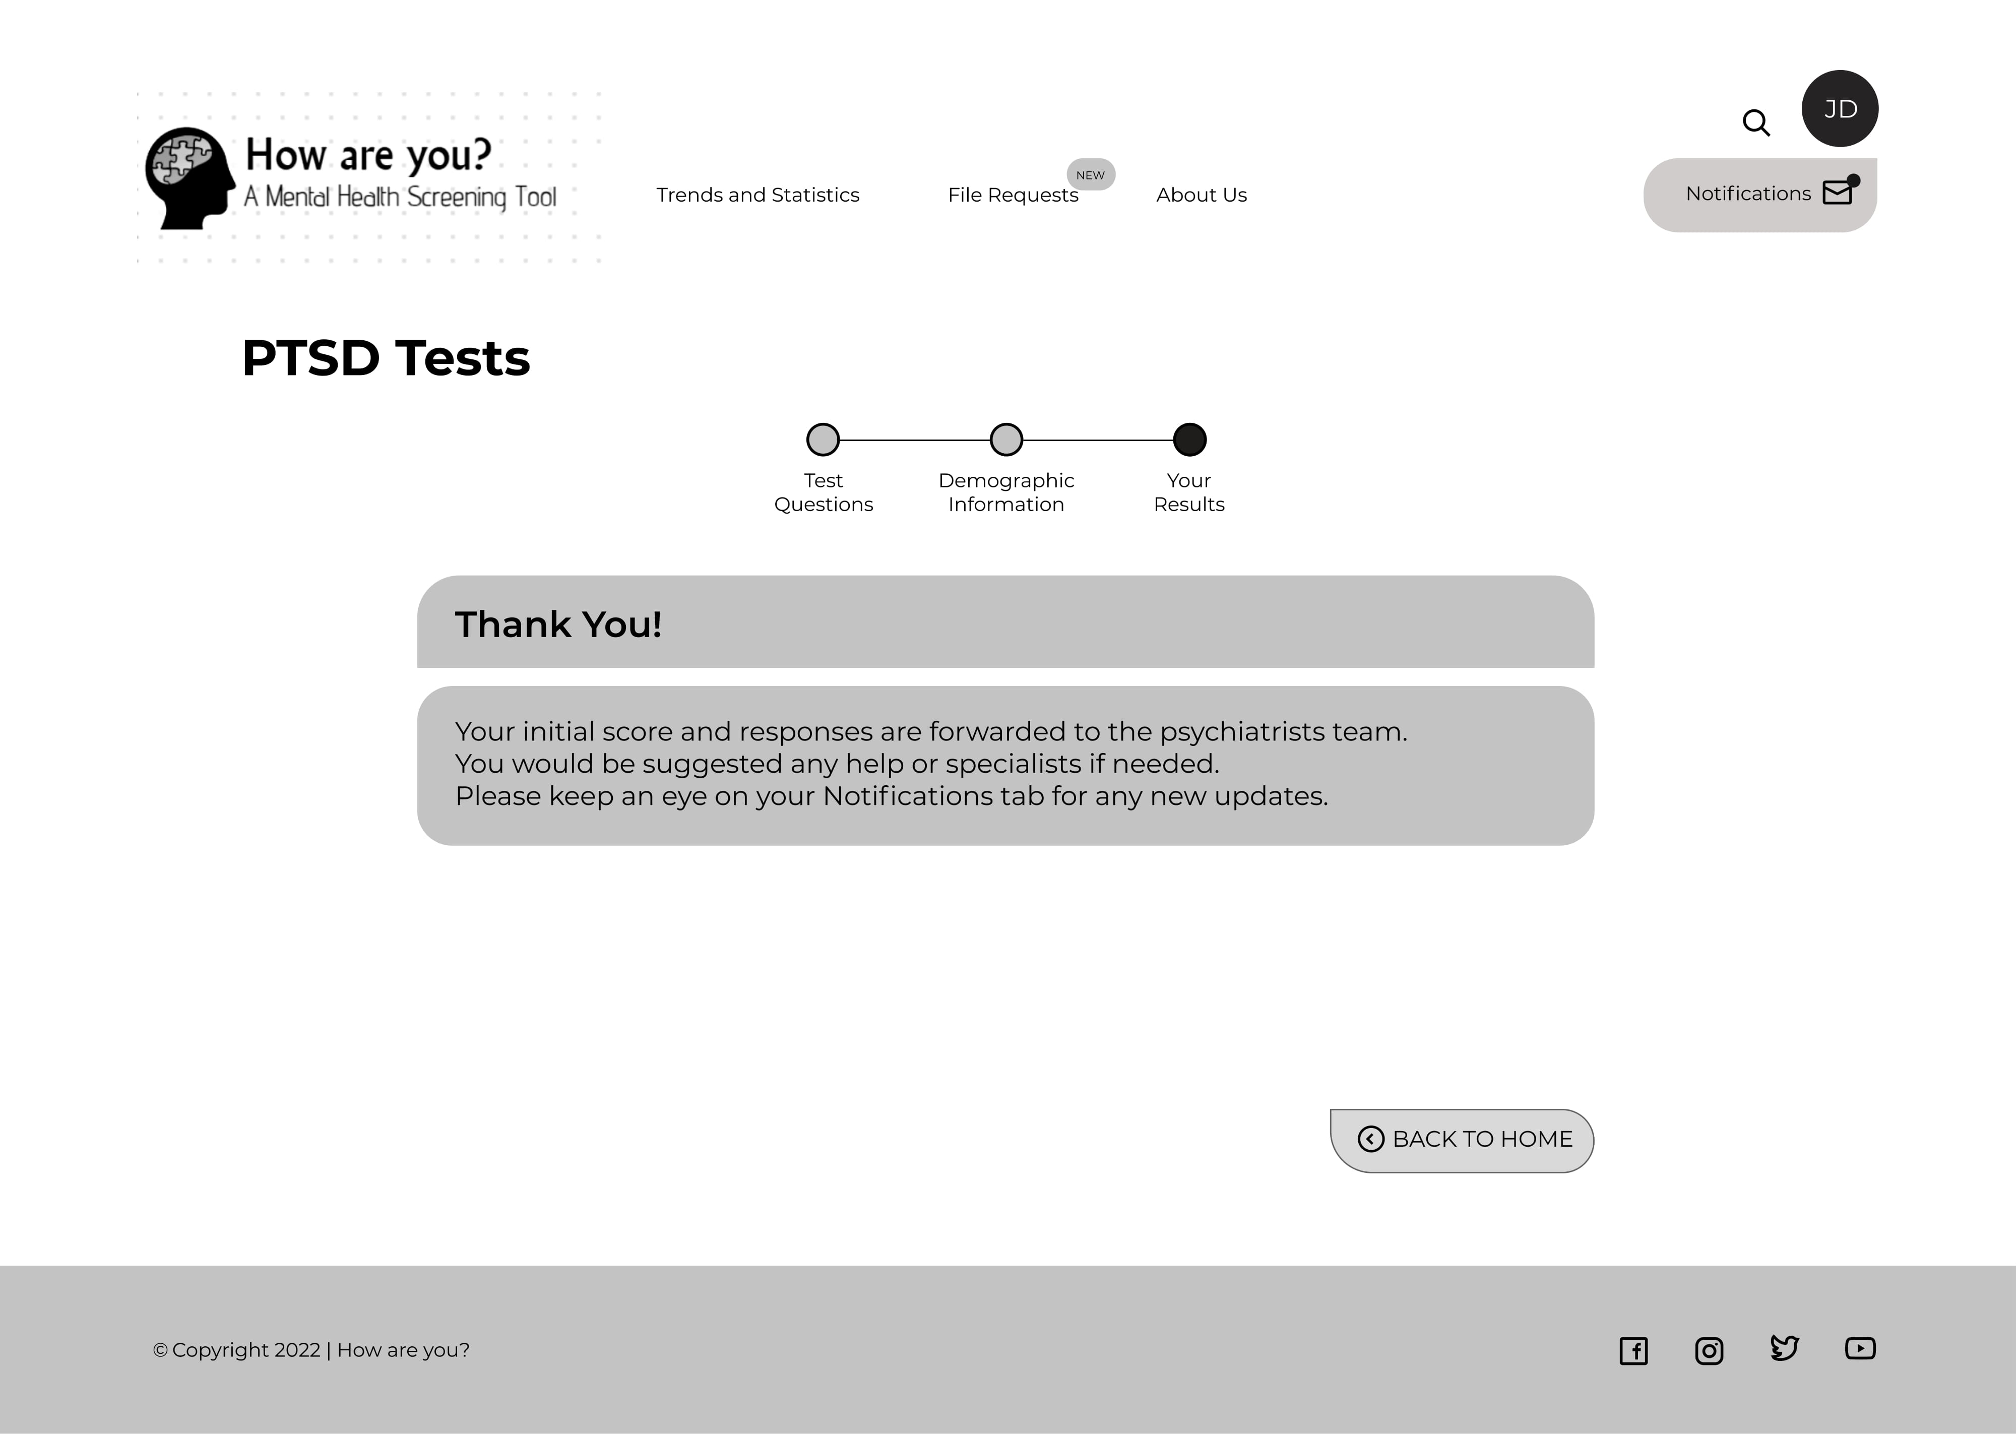

Slide 21
Home
Visitor
Patient
Psychiatrist

Slide 22
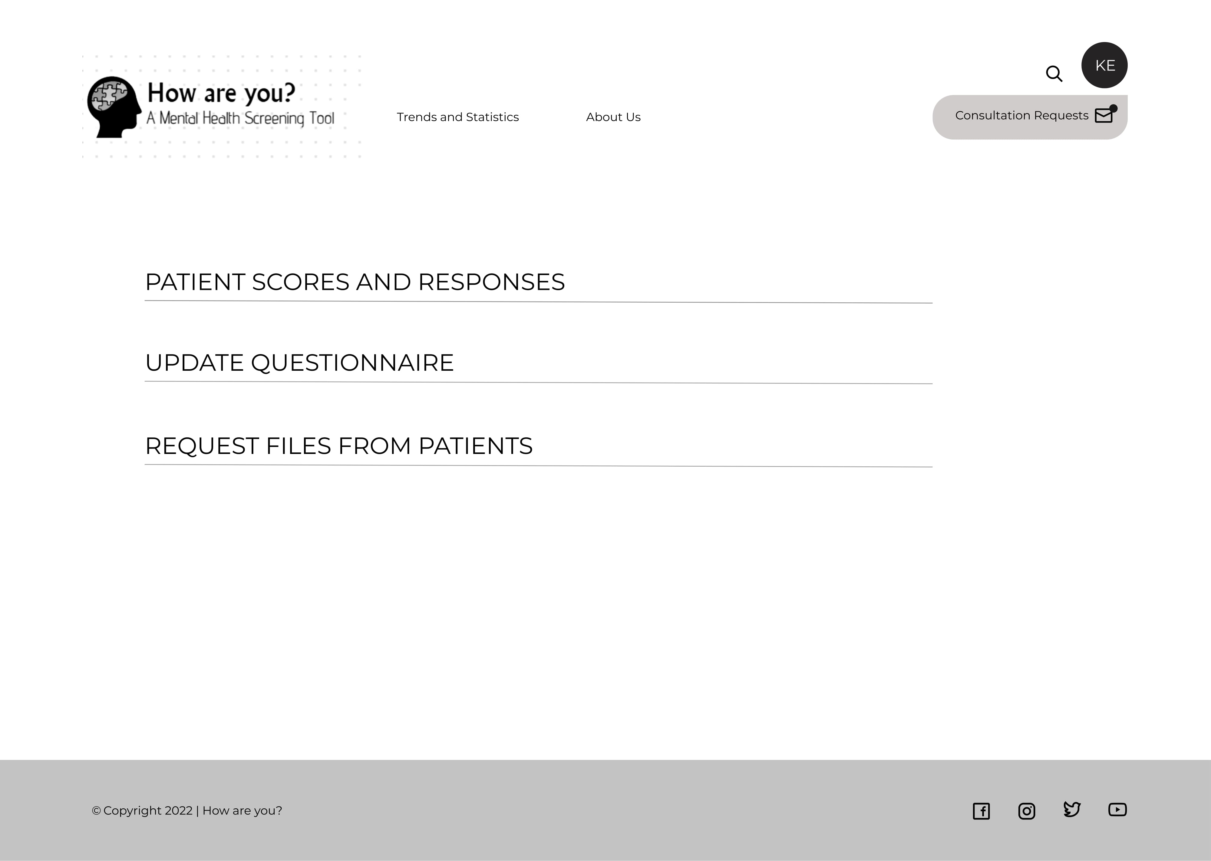

Slide 23
ACTIONS

Slide 24
PSYCHIATRIST

Slide 25
Psychiatrist Actions
Receive Patient Scores and Responses
Consultation Requests
Request Files from Patients
Update Questionnaire

Slide 26
Psychiatrist Actions
Receive Patient Scores and Responses
Consultation Requests
Request Files from Patients
Update Questionnaire

Slide 27
Psychiatrist checks patient responses and suggests appropriate specialists

Slide 28
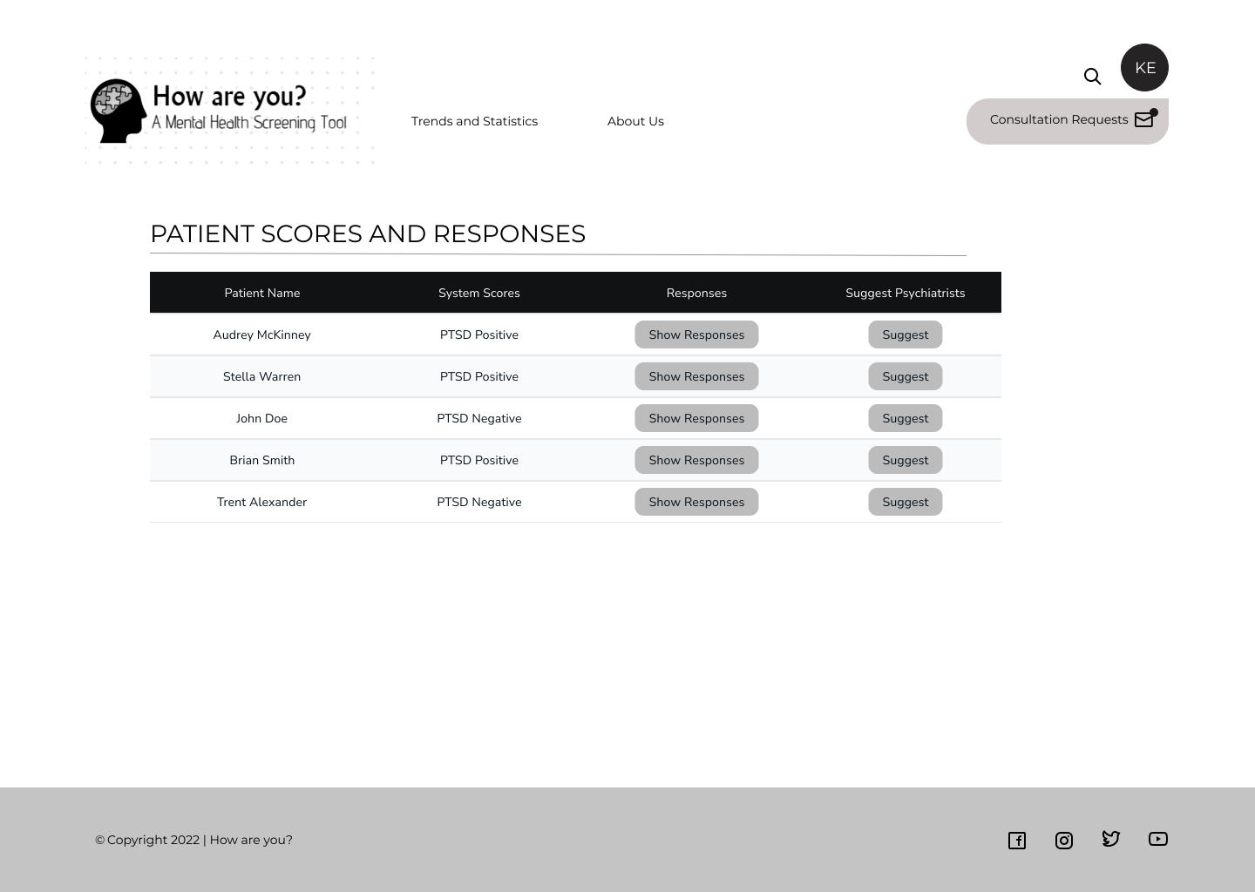

Slide 29
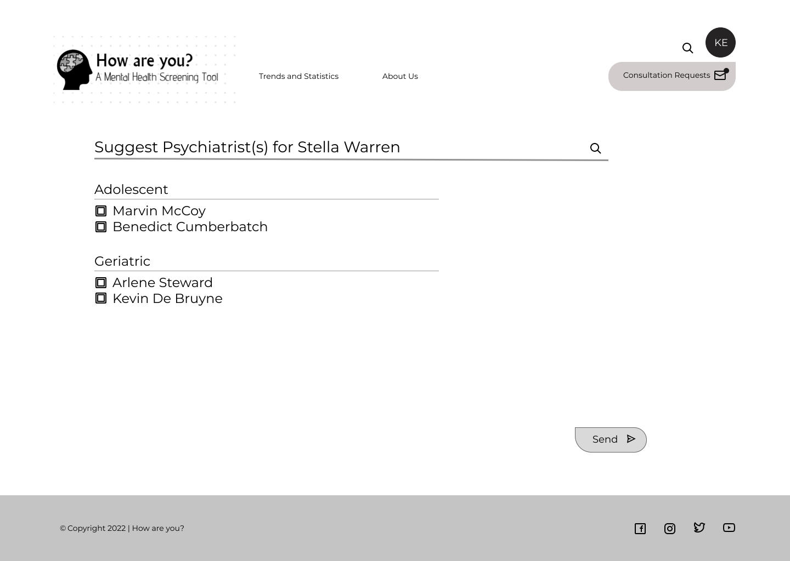

Slide 30
Patient receives psychiatrist verifications through Notifications

Slide 31
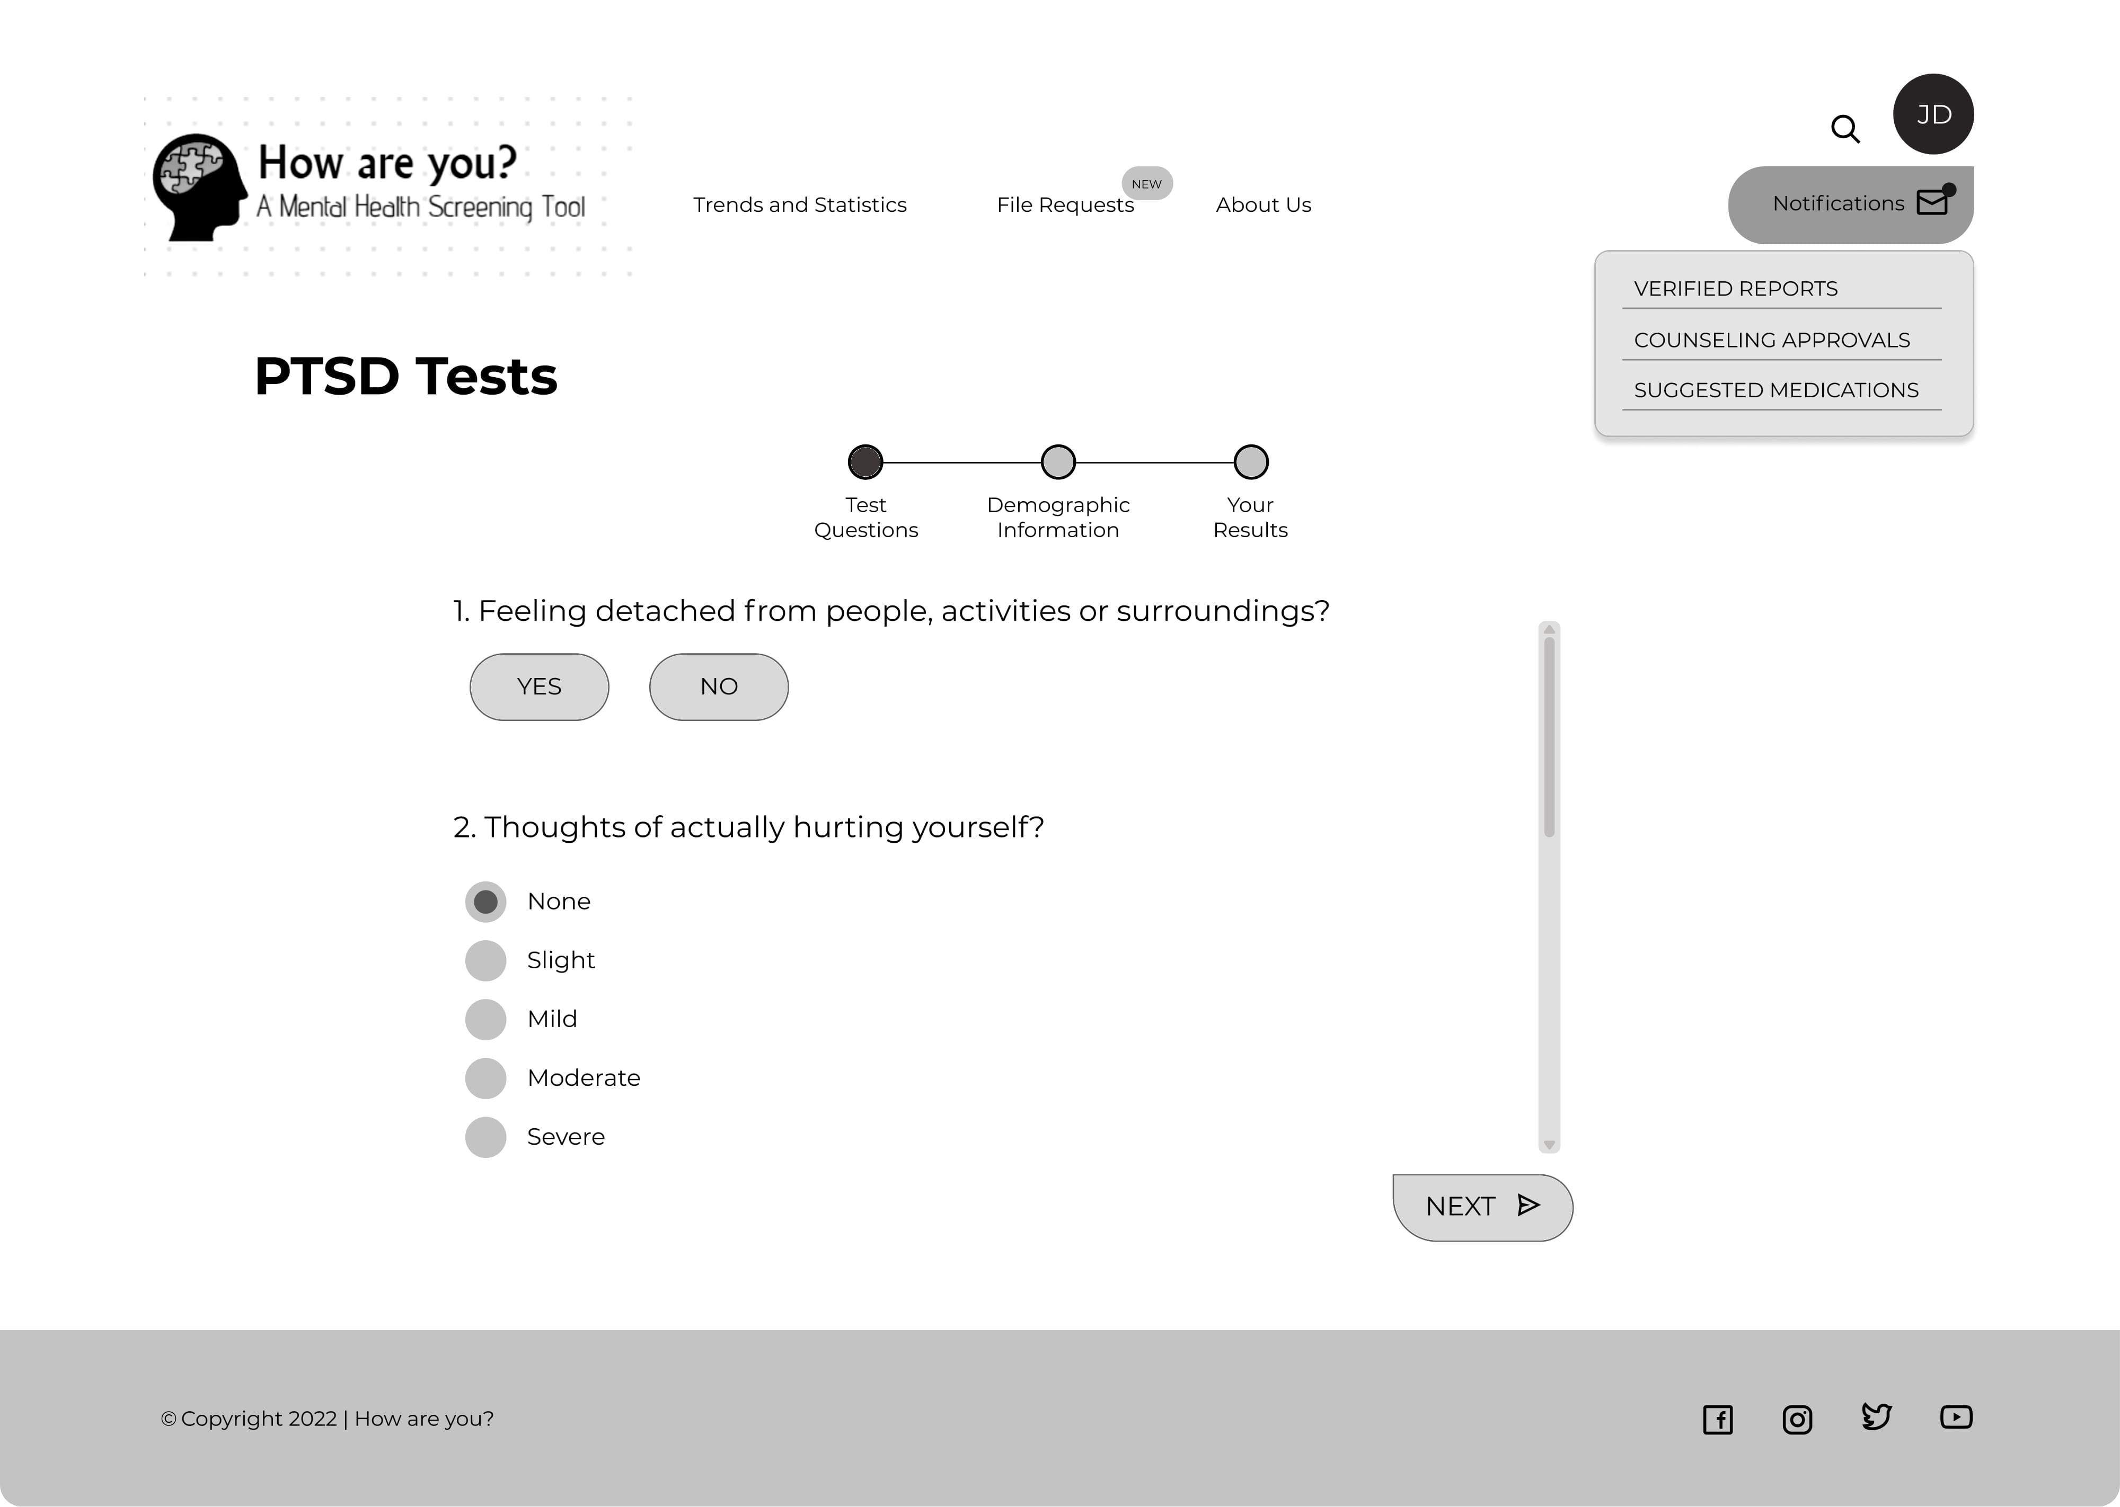

Slide 32
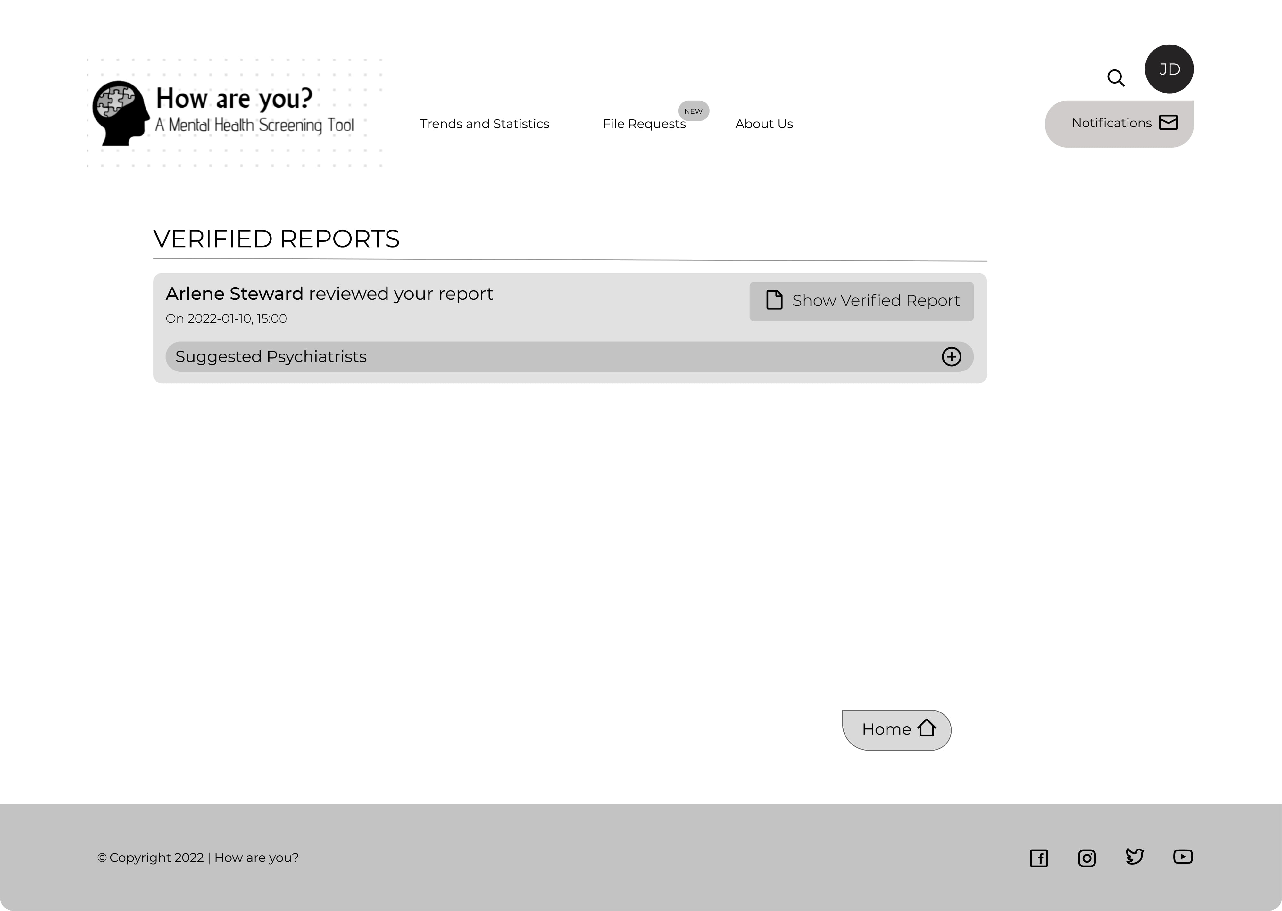

Slide 33
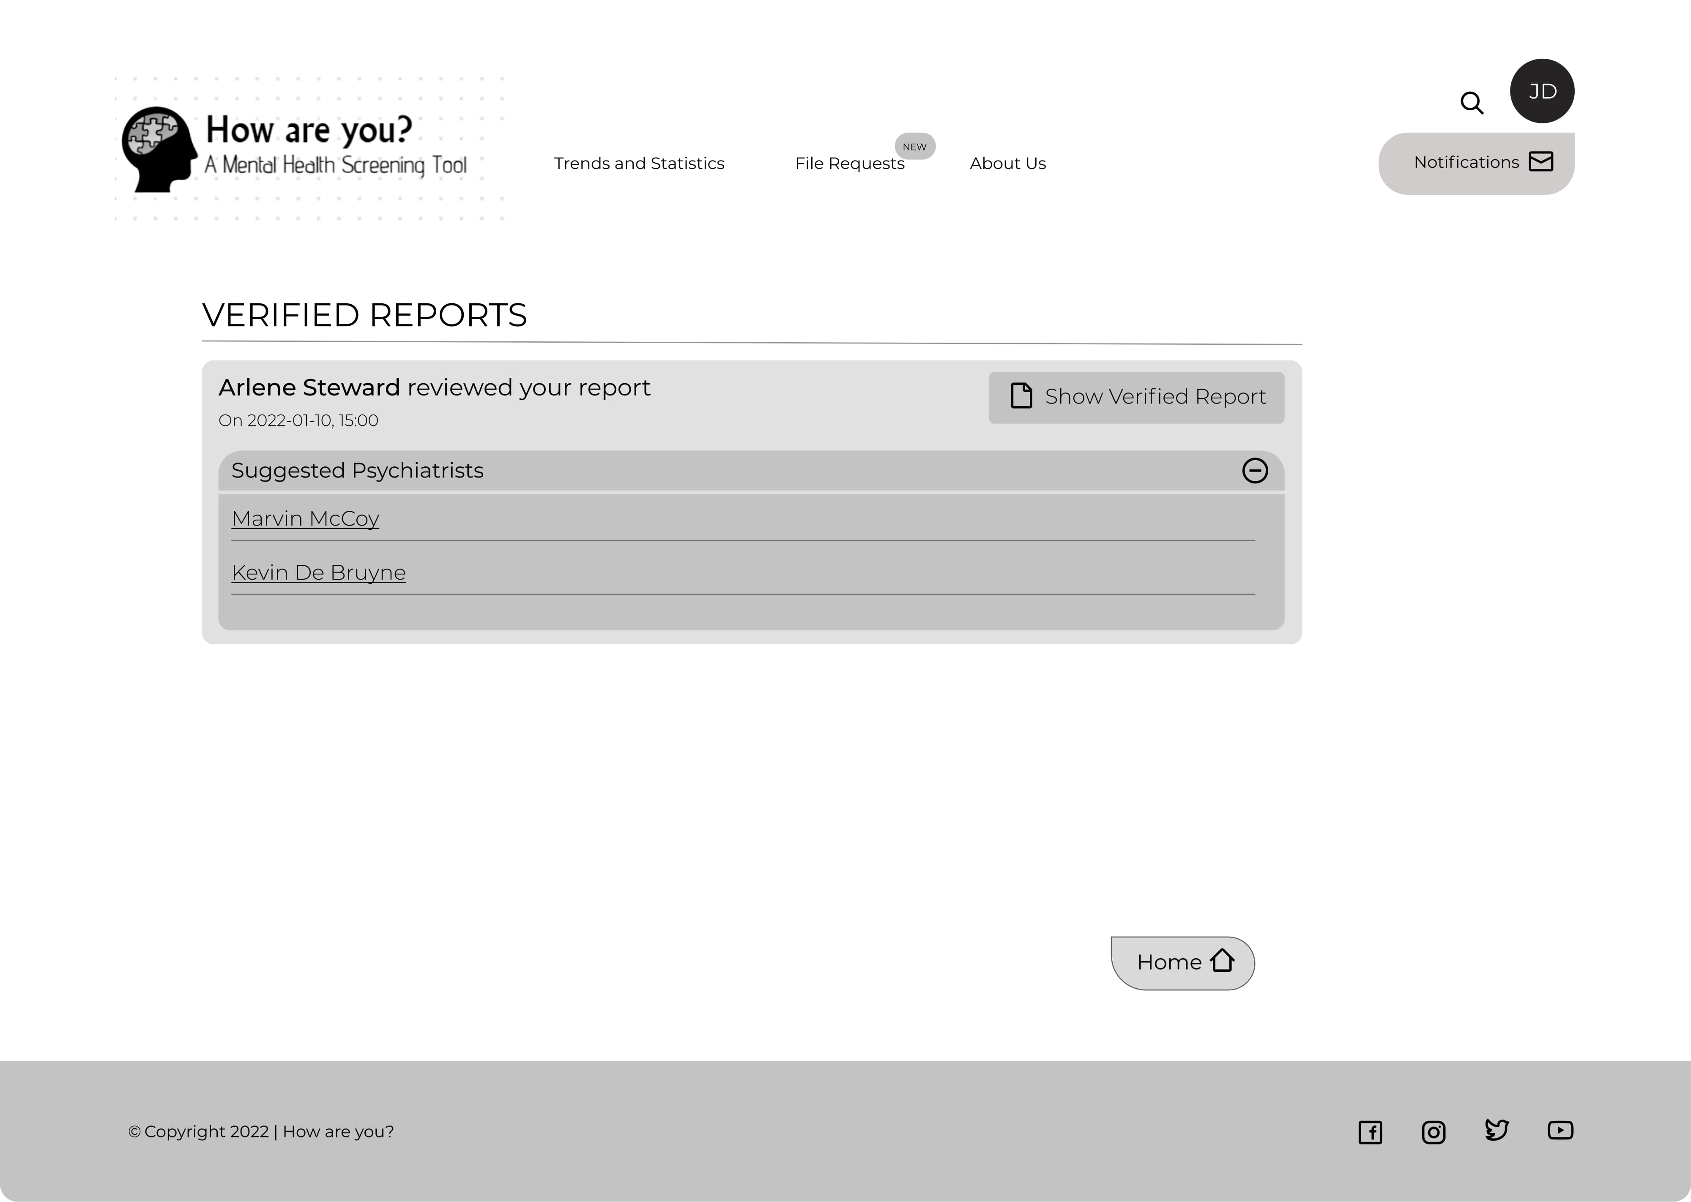

Slide 34
Patient may view the specialists’ public detail and send consultation requests accordingly

Slide 35
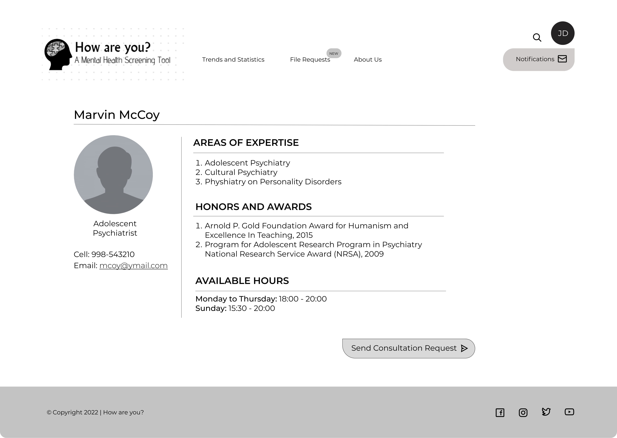

Slide 36
Psychiatrist Actions
Receive Patient Scores and Responses
Consultation Requests
Request Files from Patients
Update Questionnaire

Slide 37
Psychiatrist receives Consultation Requests through Notification and may specify a Counseling Time, Method or suggest Medication

Slide 38
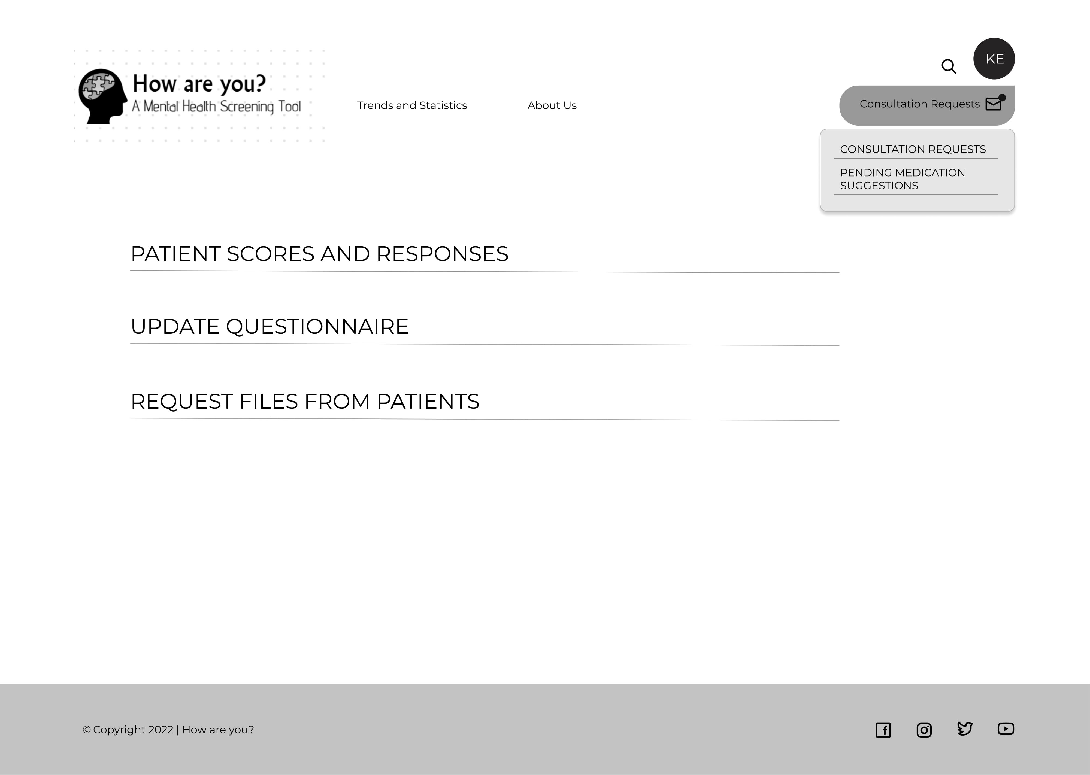

Slide 39
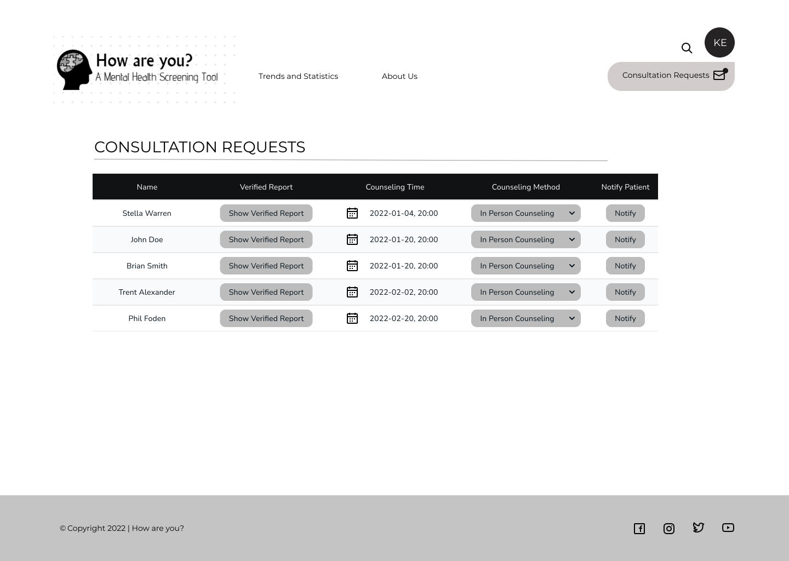

Slide 40
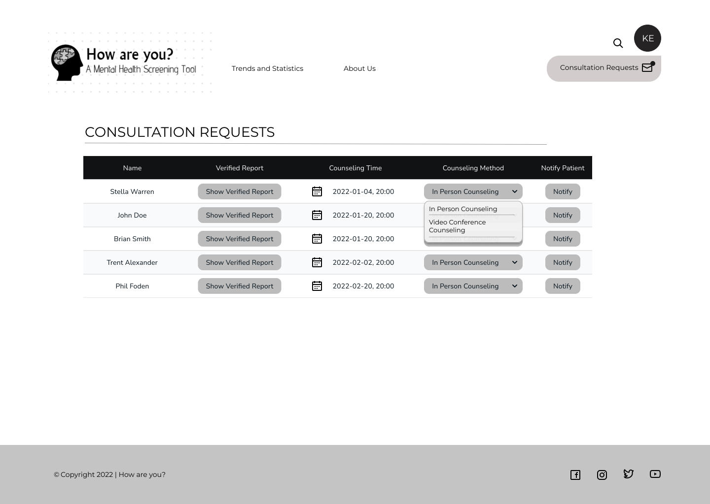

Slide 41
Patient gets corresponding Counseling Approval Notifications

Slide 42
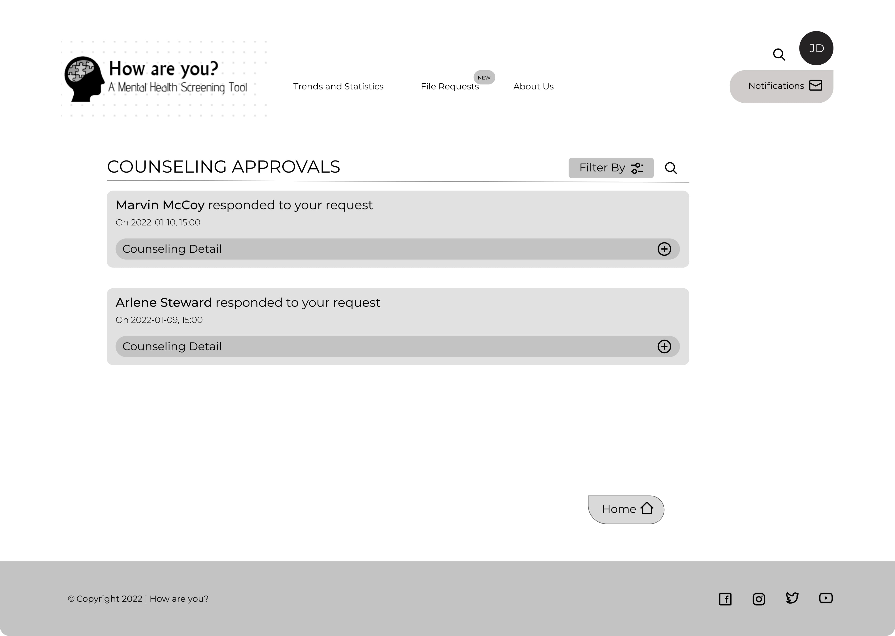

Slide 43
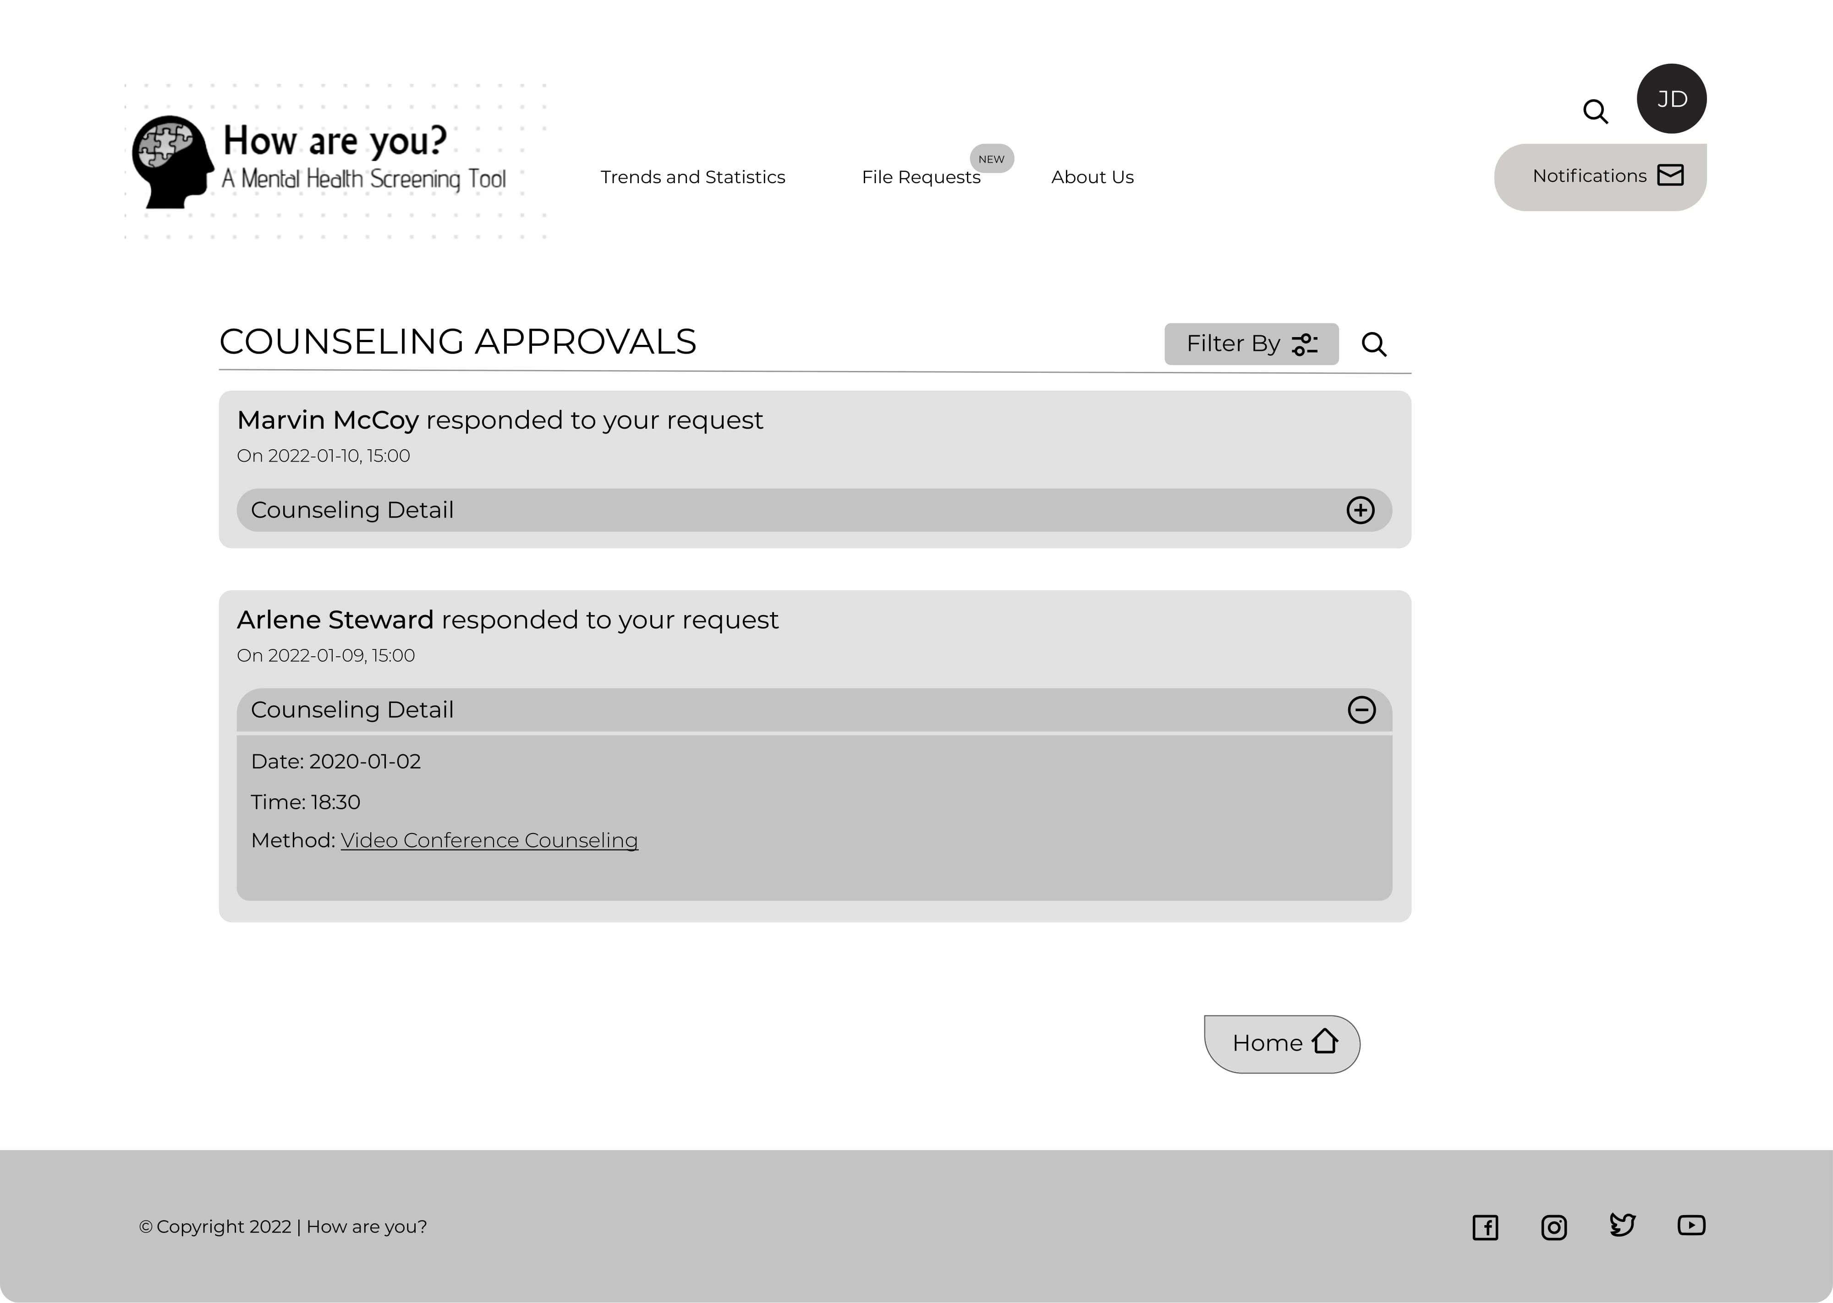

Slide 44
Counseling may follow prescribing medications

Slide 45
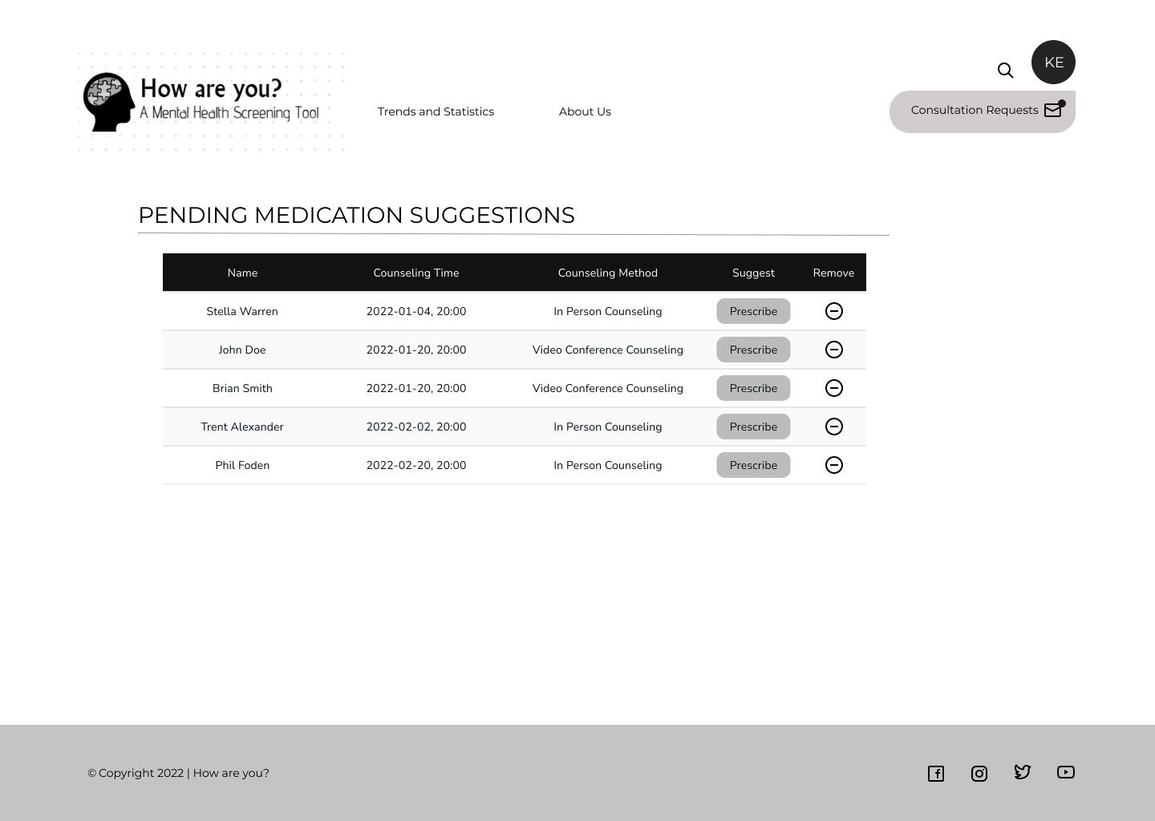

Slide 46
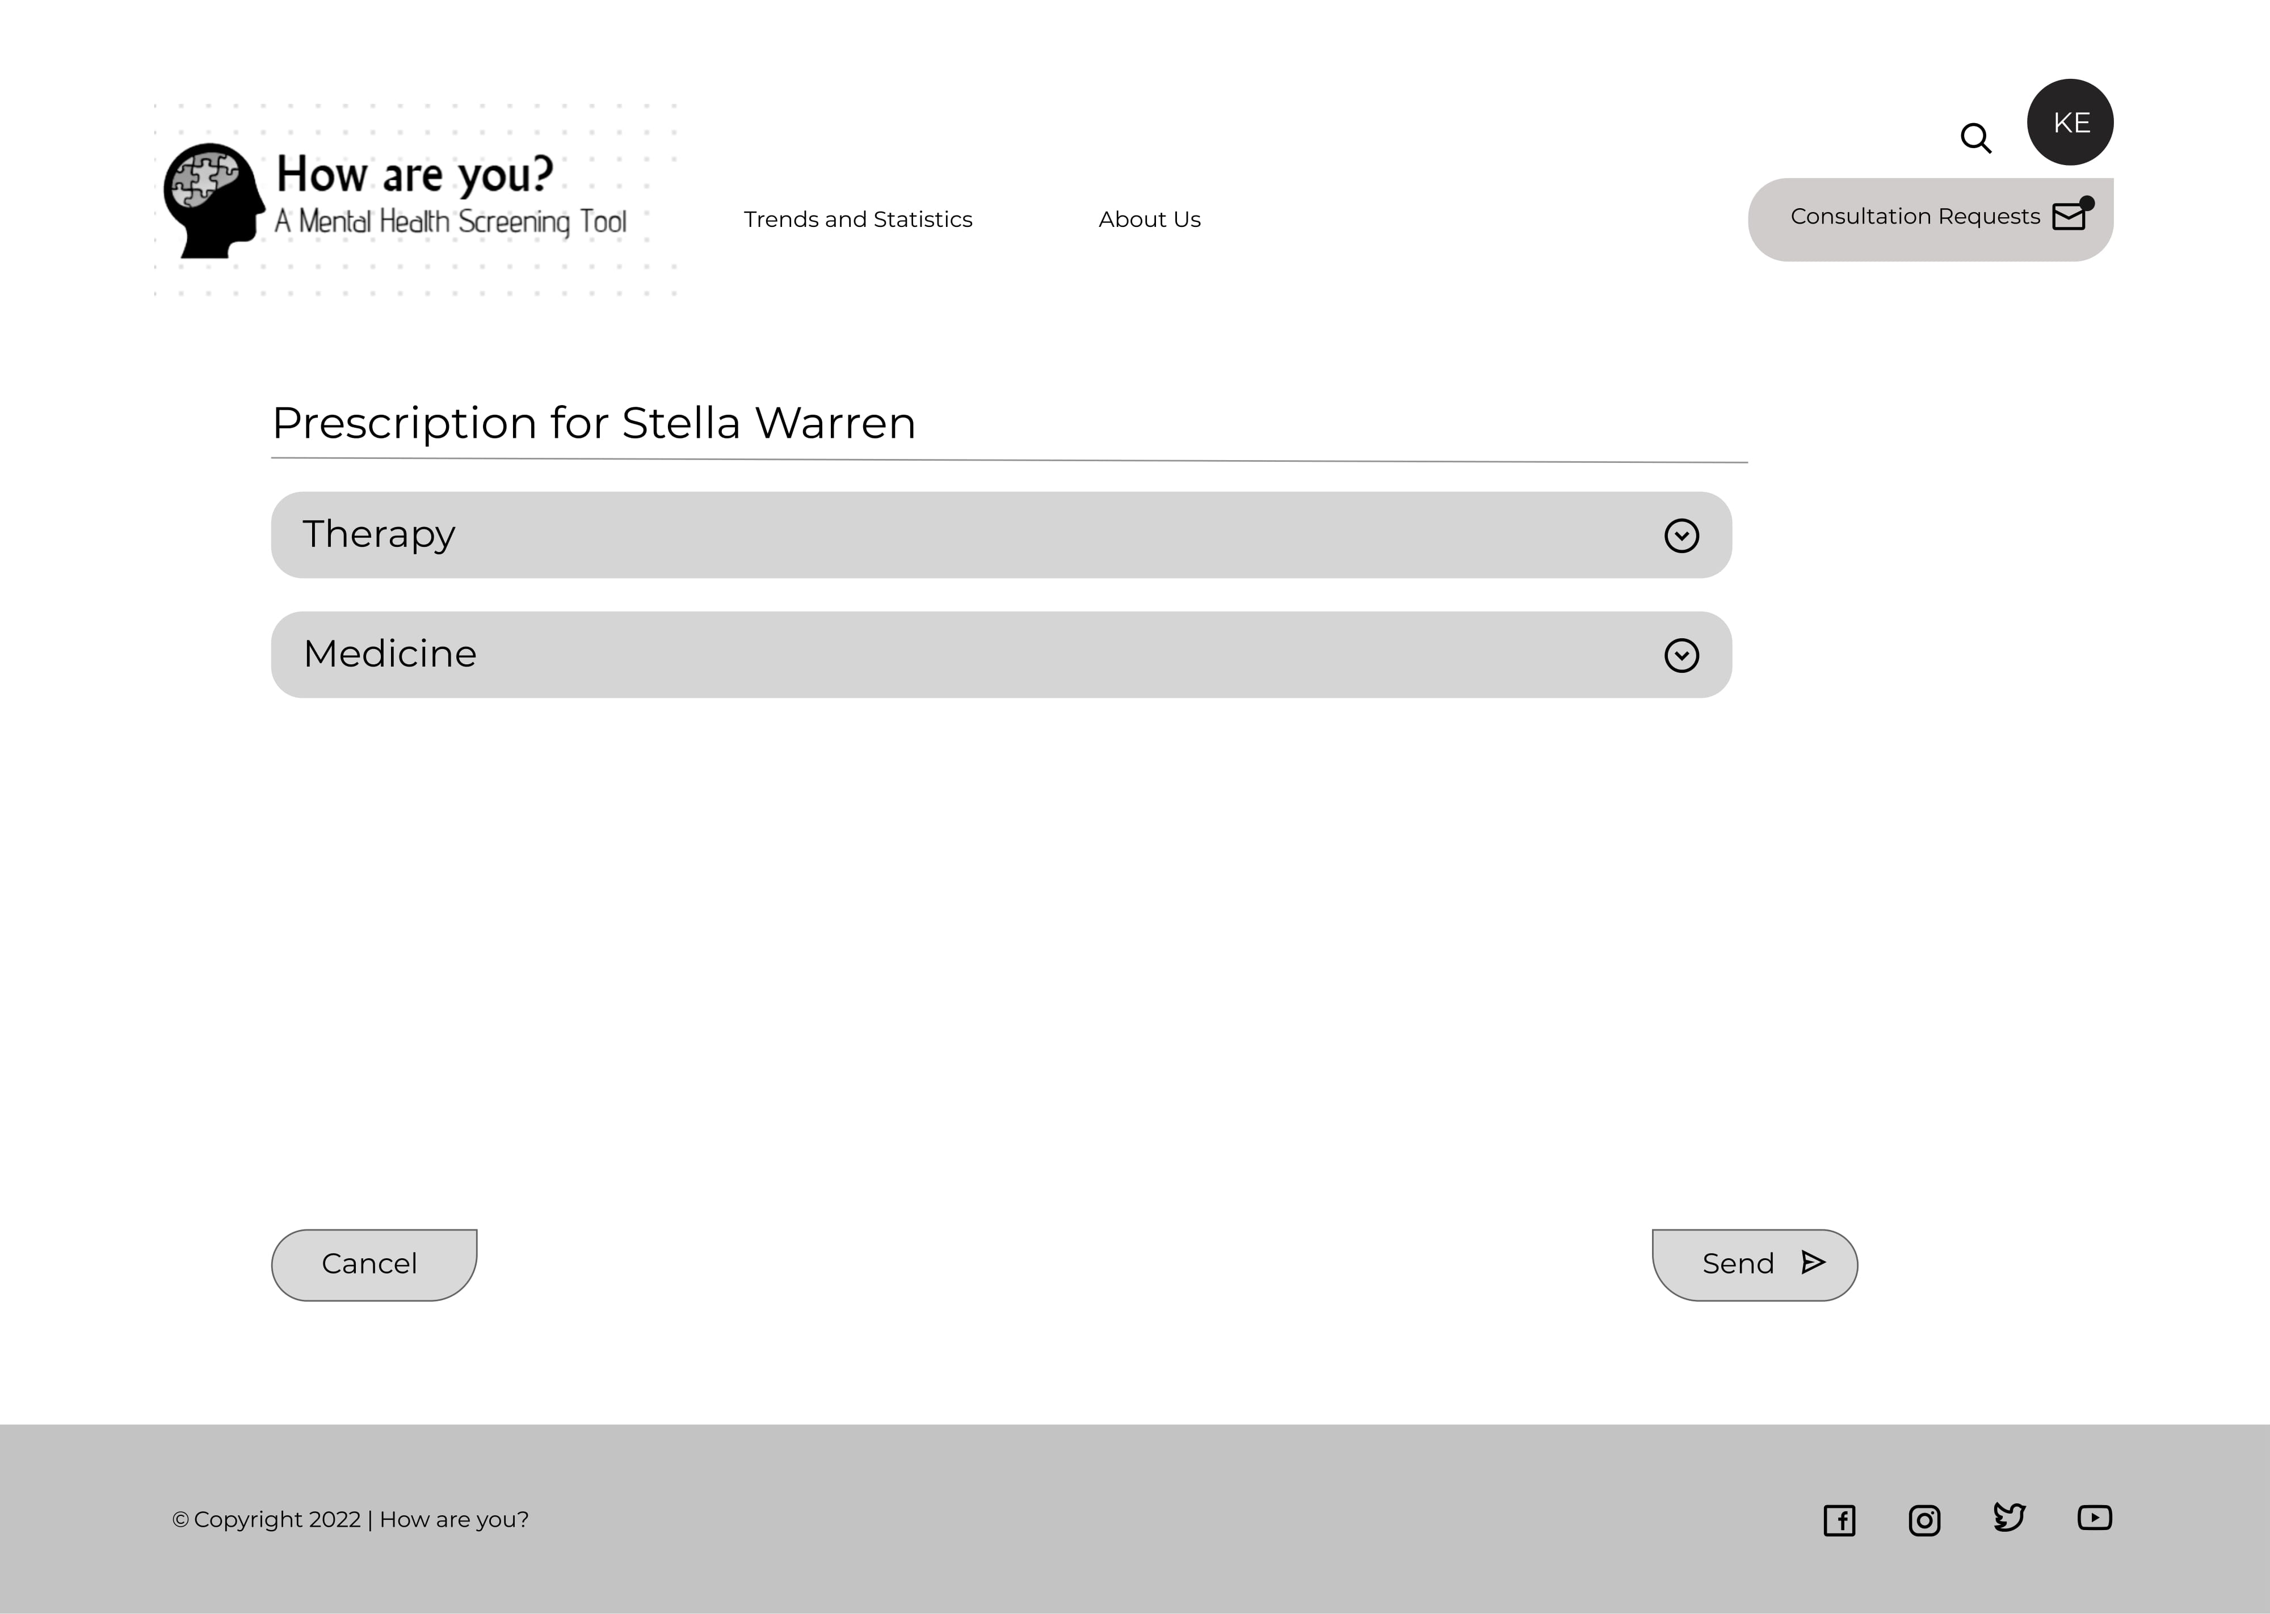

Slide 47
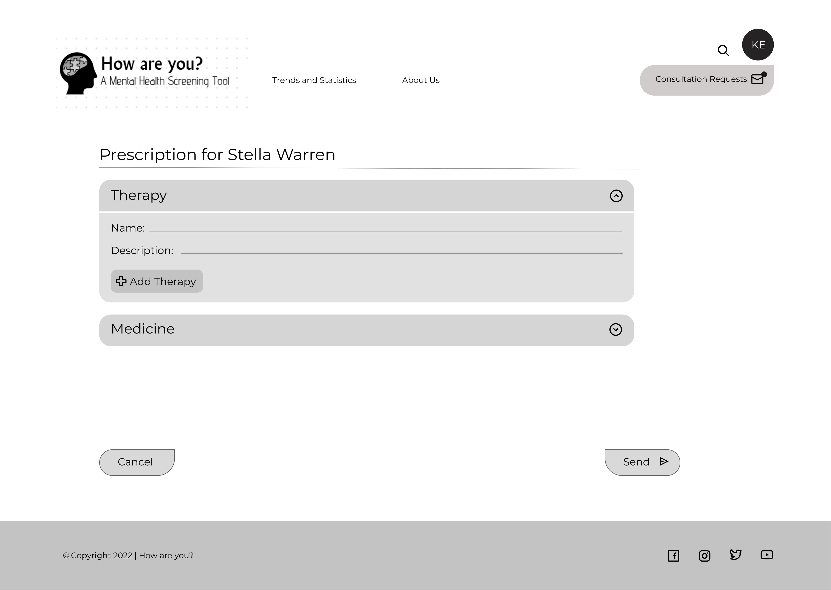

Slide 48
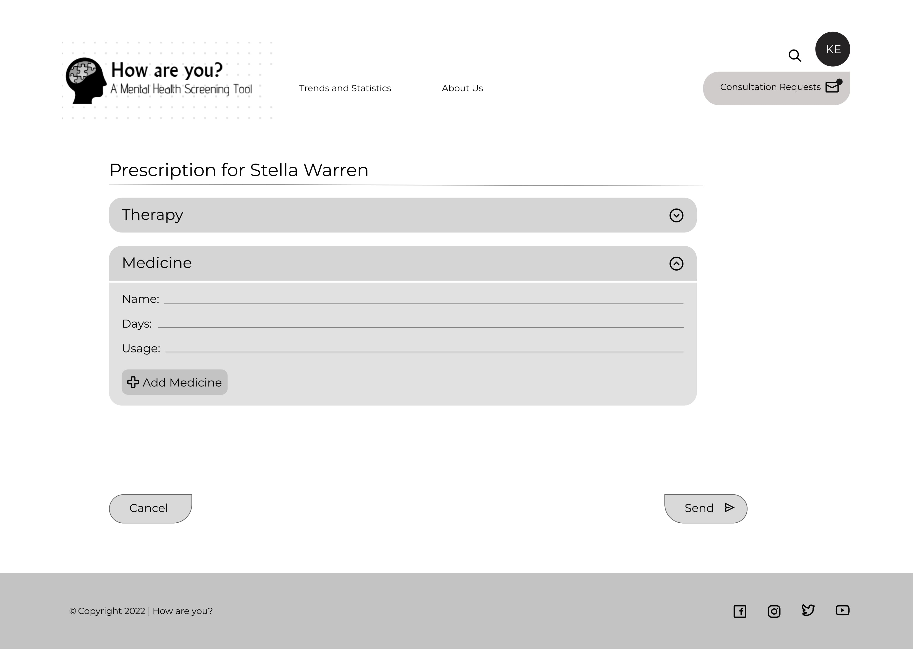

Slide 49
Patient is notified of the Medication suggestions

Slide 50
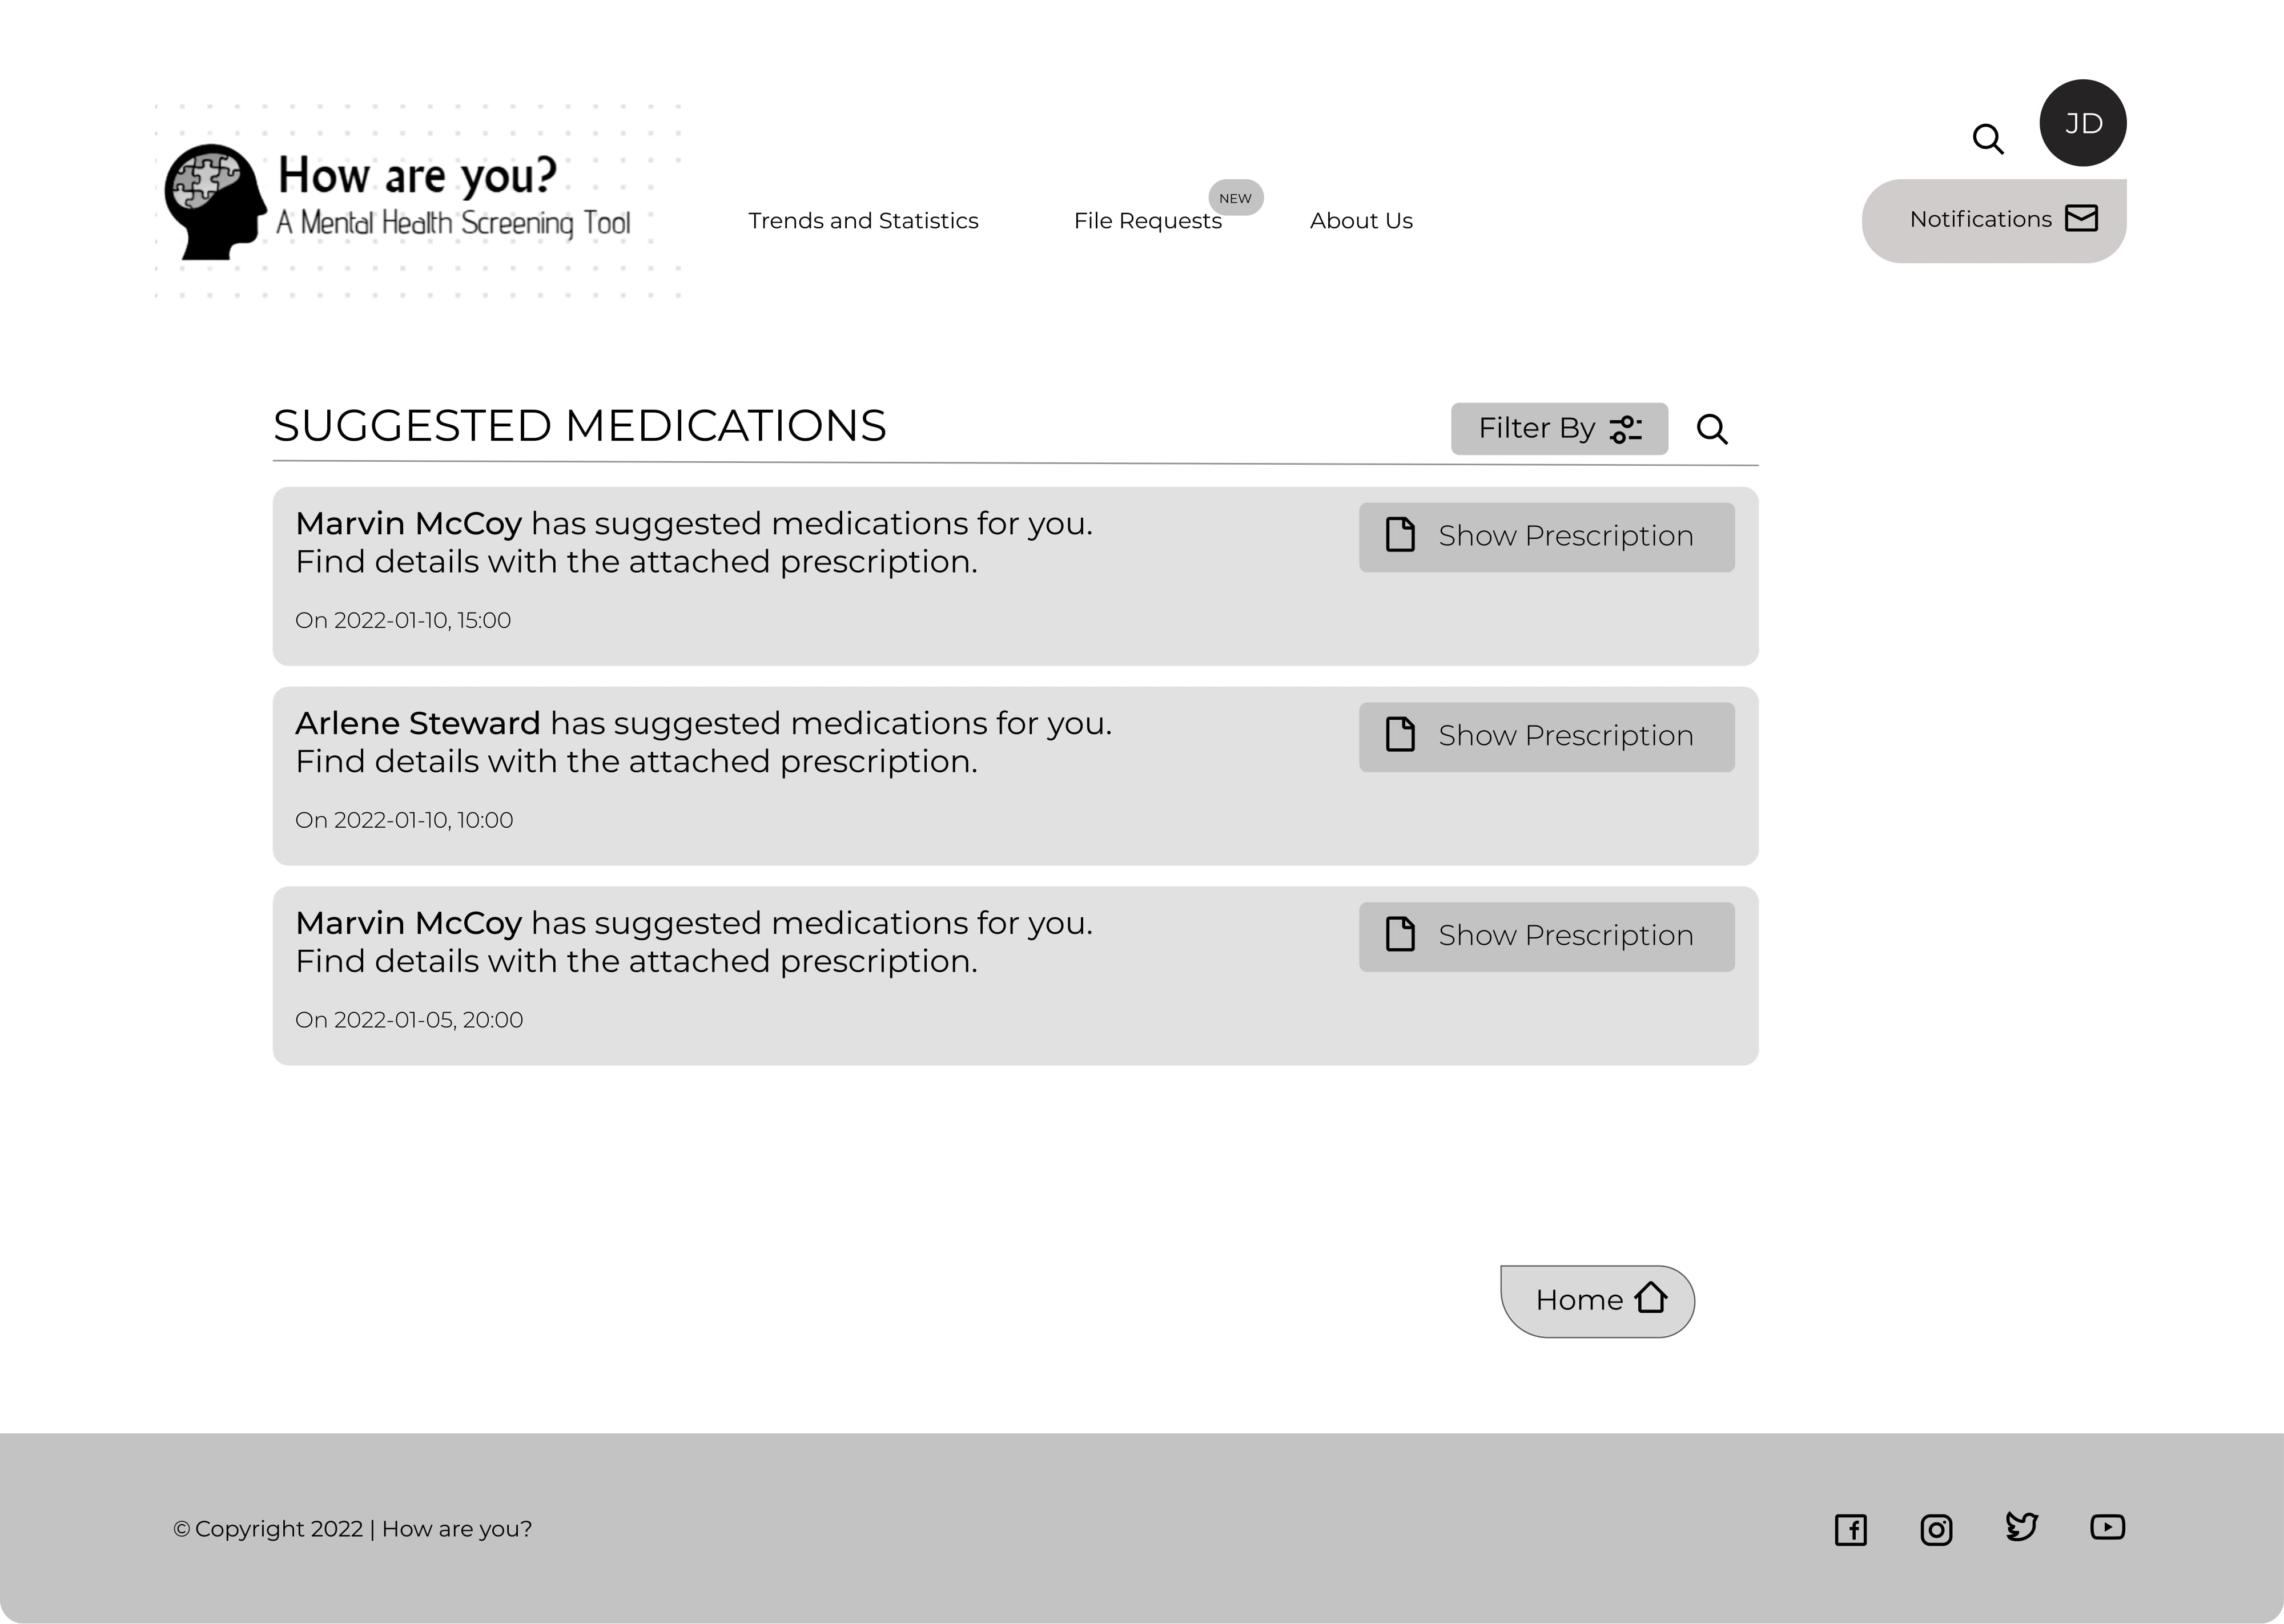

Slide 51
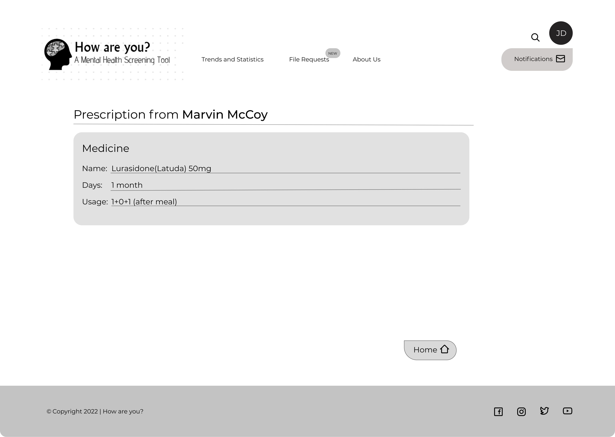

Slide 52
Psychiatrist Actions
Receive Patient Scores and Responses
Consultation Requests
Request Files from Patients
Update Questionnaire

Slide 53
Psychiatrist may specify a file type along with descriptions with a view to broadcasting among all patients that might later facilitate the Q/A purpose

Slide 54
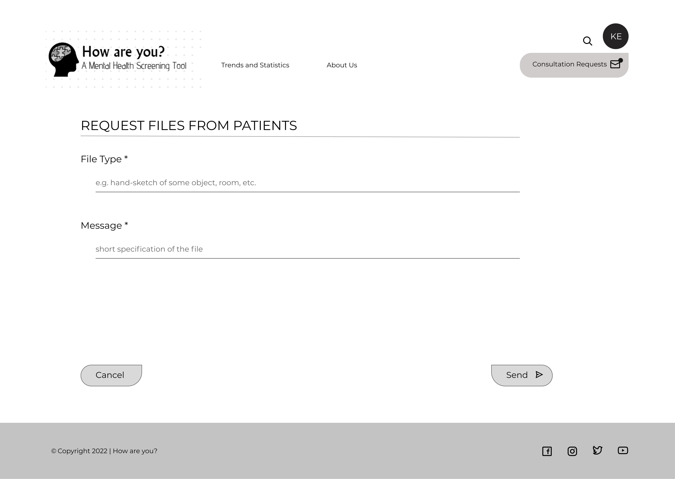

Slide 55
Patient receives Requested File Notifications and may participate in the Data Collection process

Slide 56
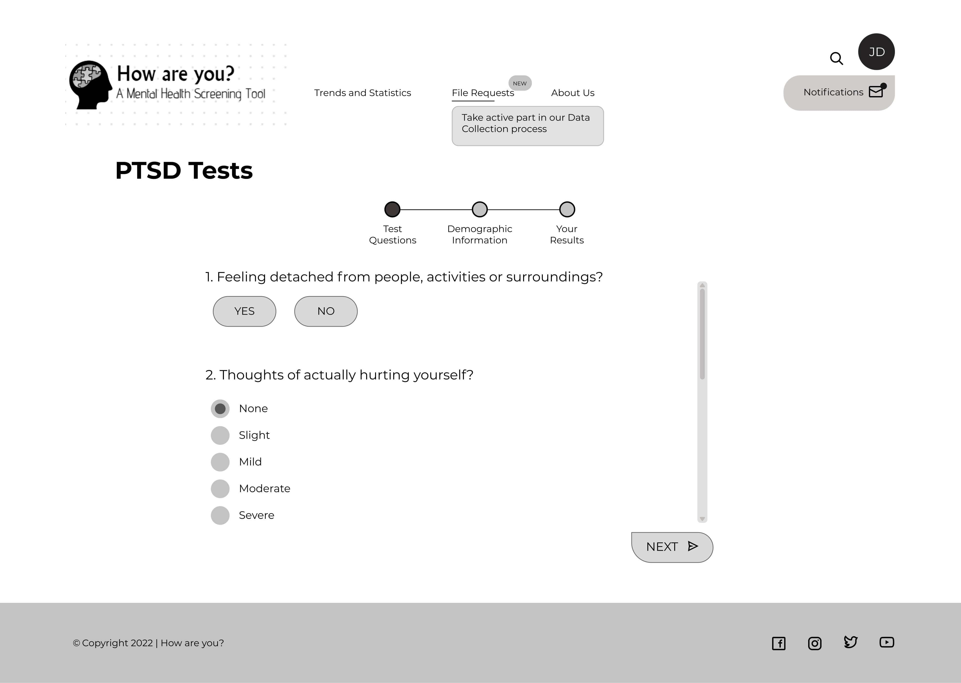

Slide 57
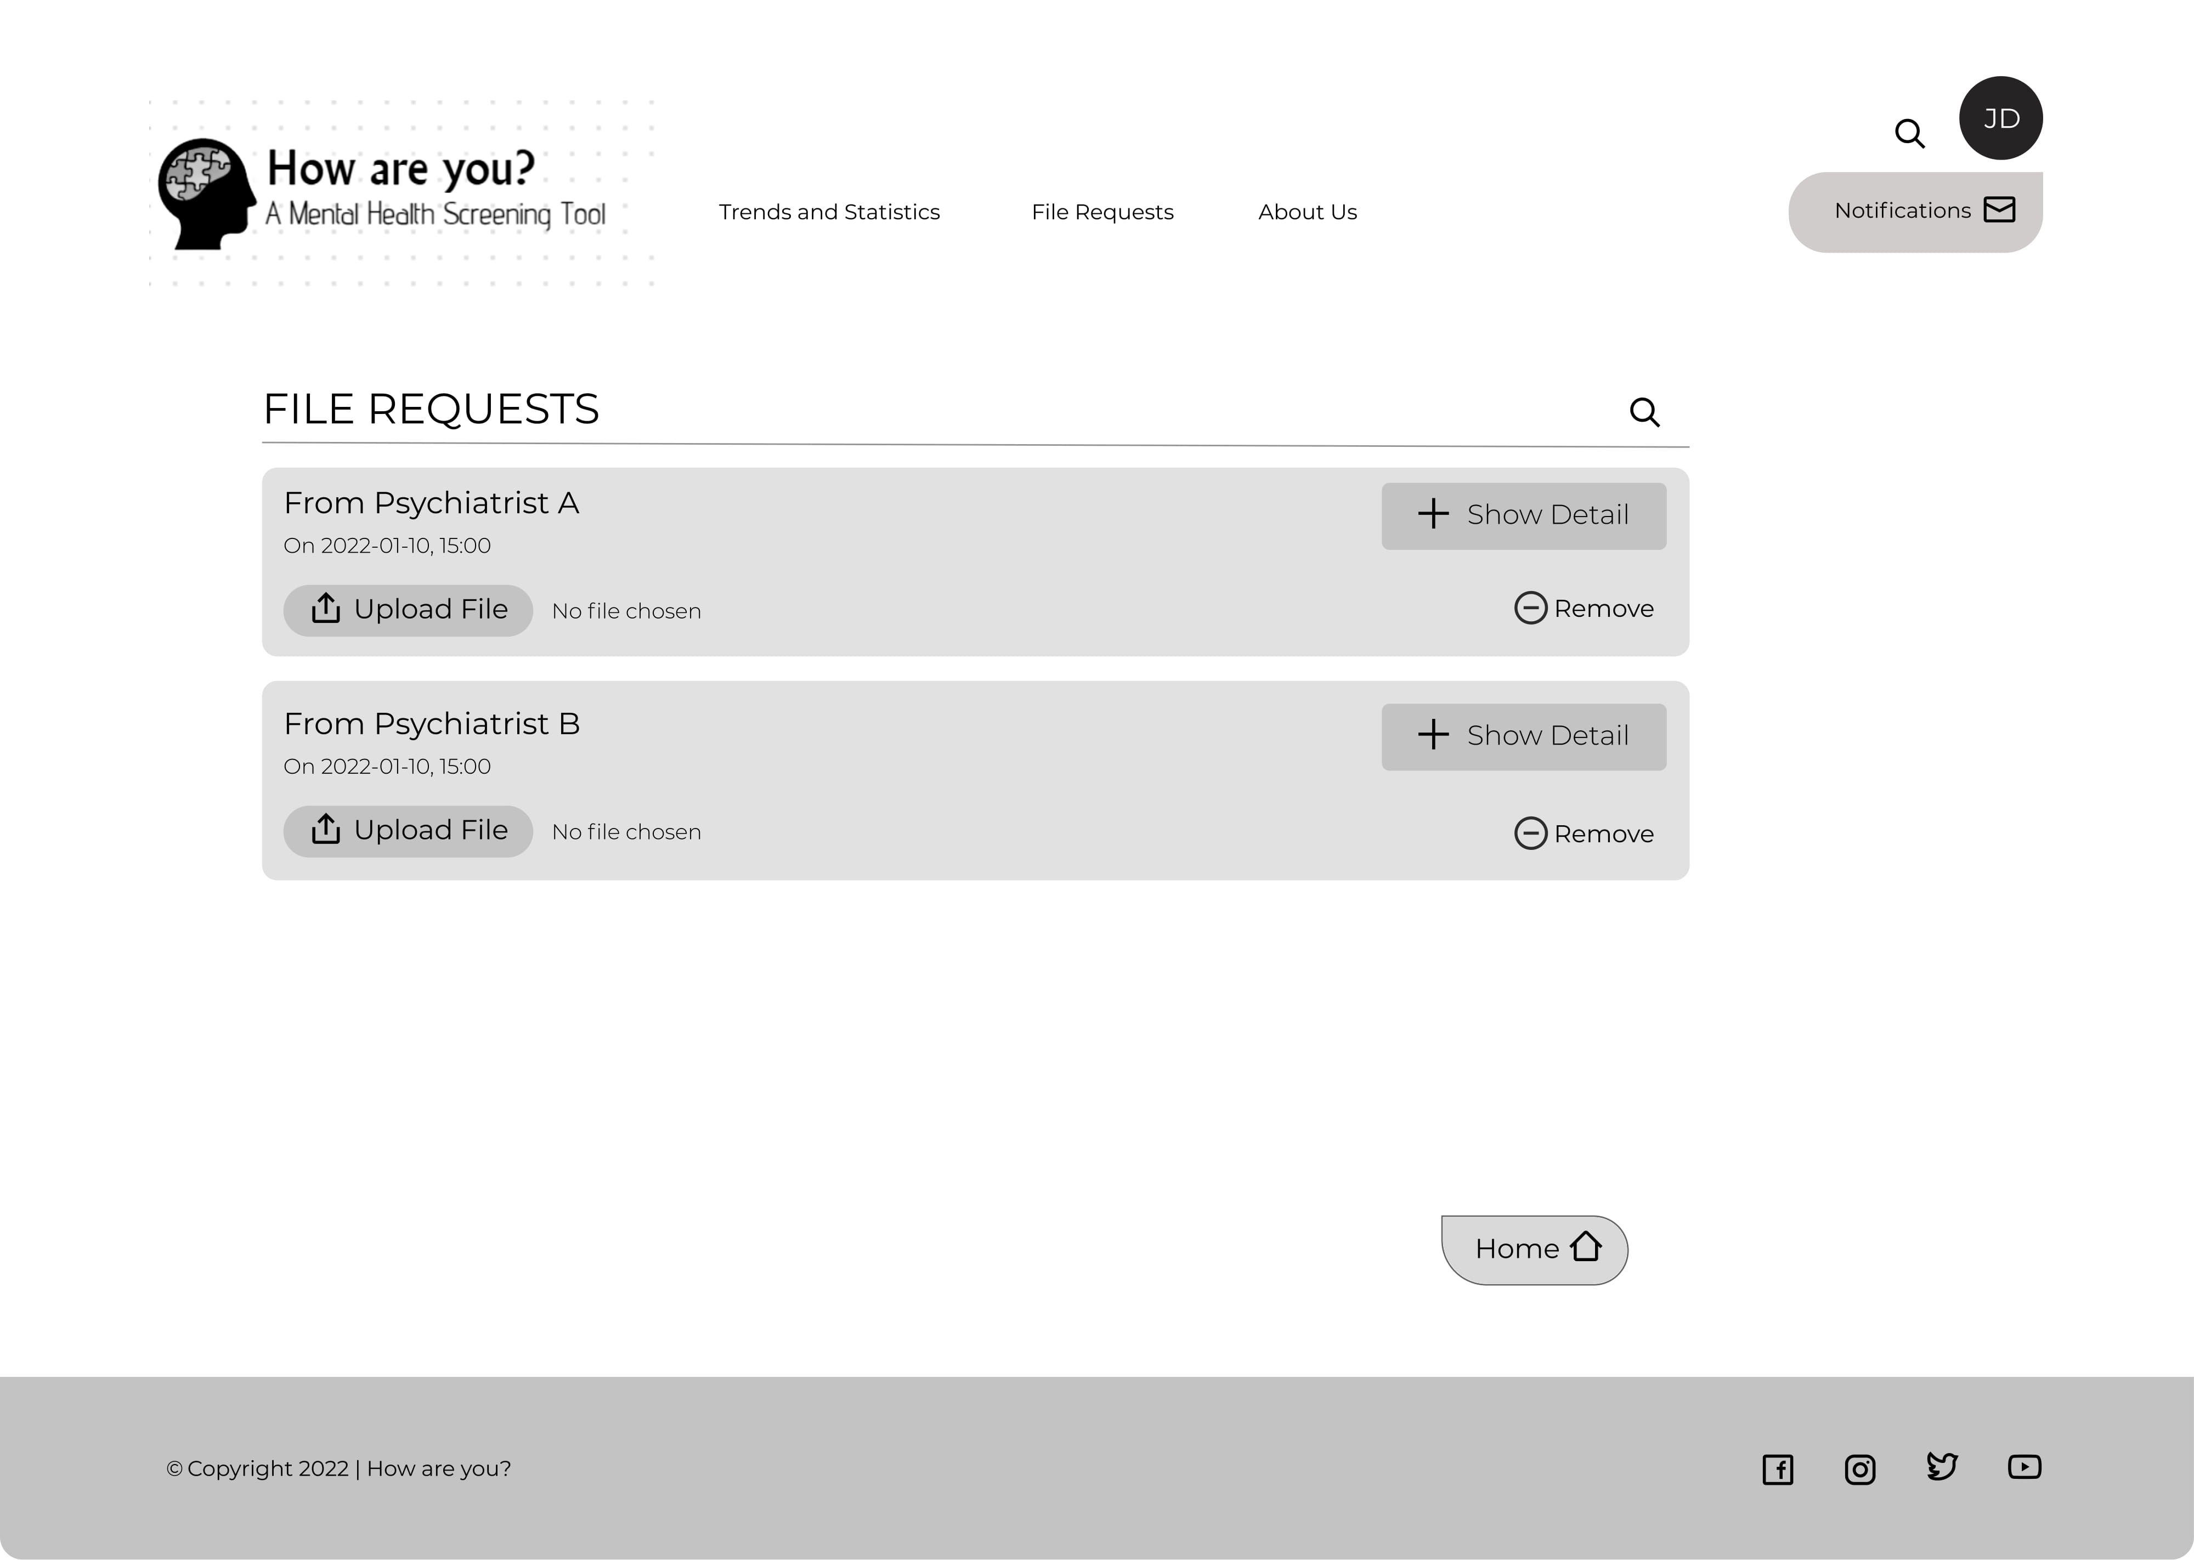

Slide 58
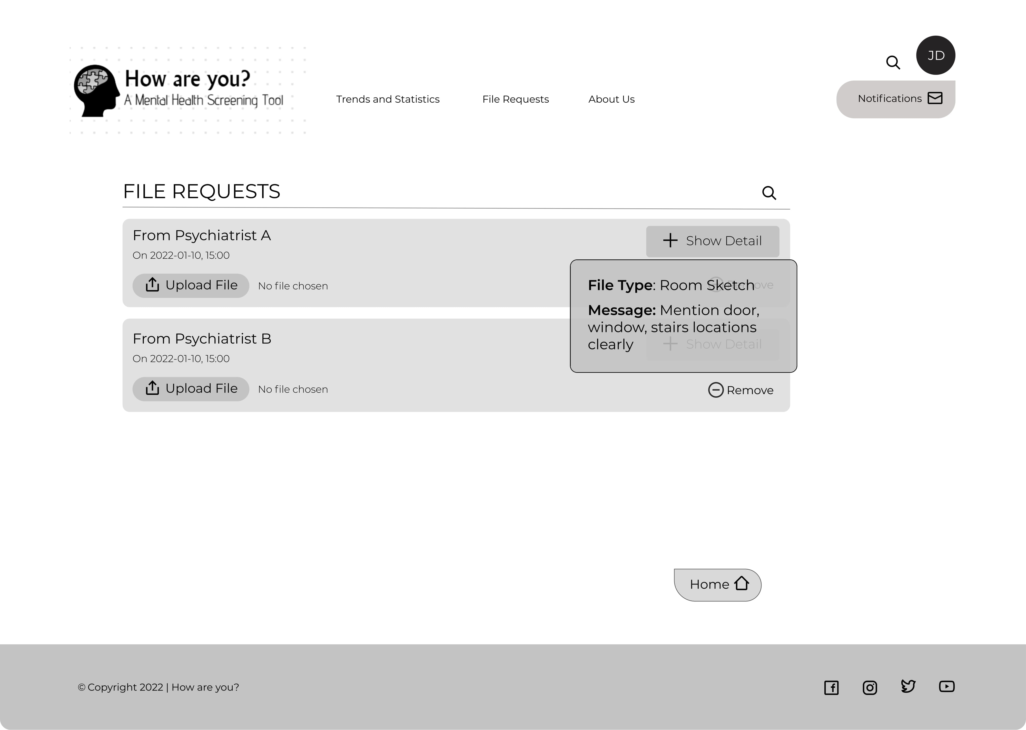

Slide 59


Slide 60
Psychiatrist Actions
Receive Patient Scores and Responses
Consultation Requests
Request Files from Patients
Update Questionnaire

Slide 61
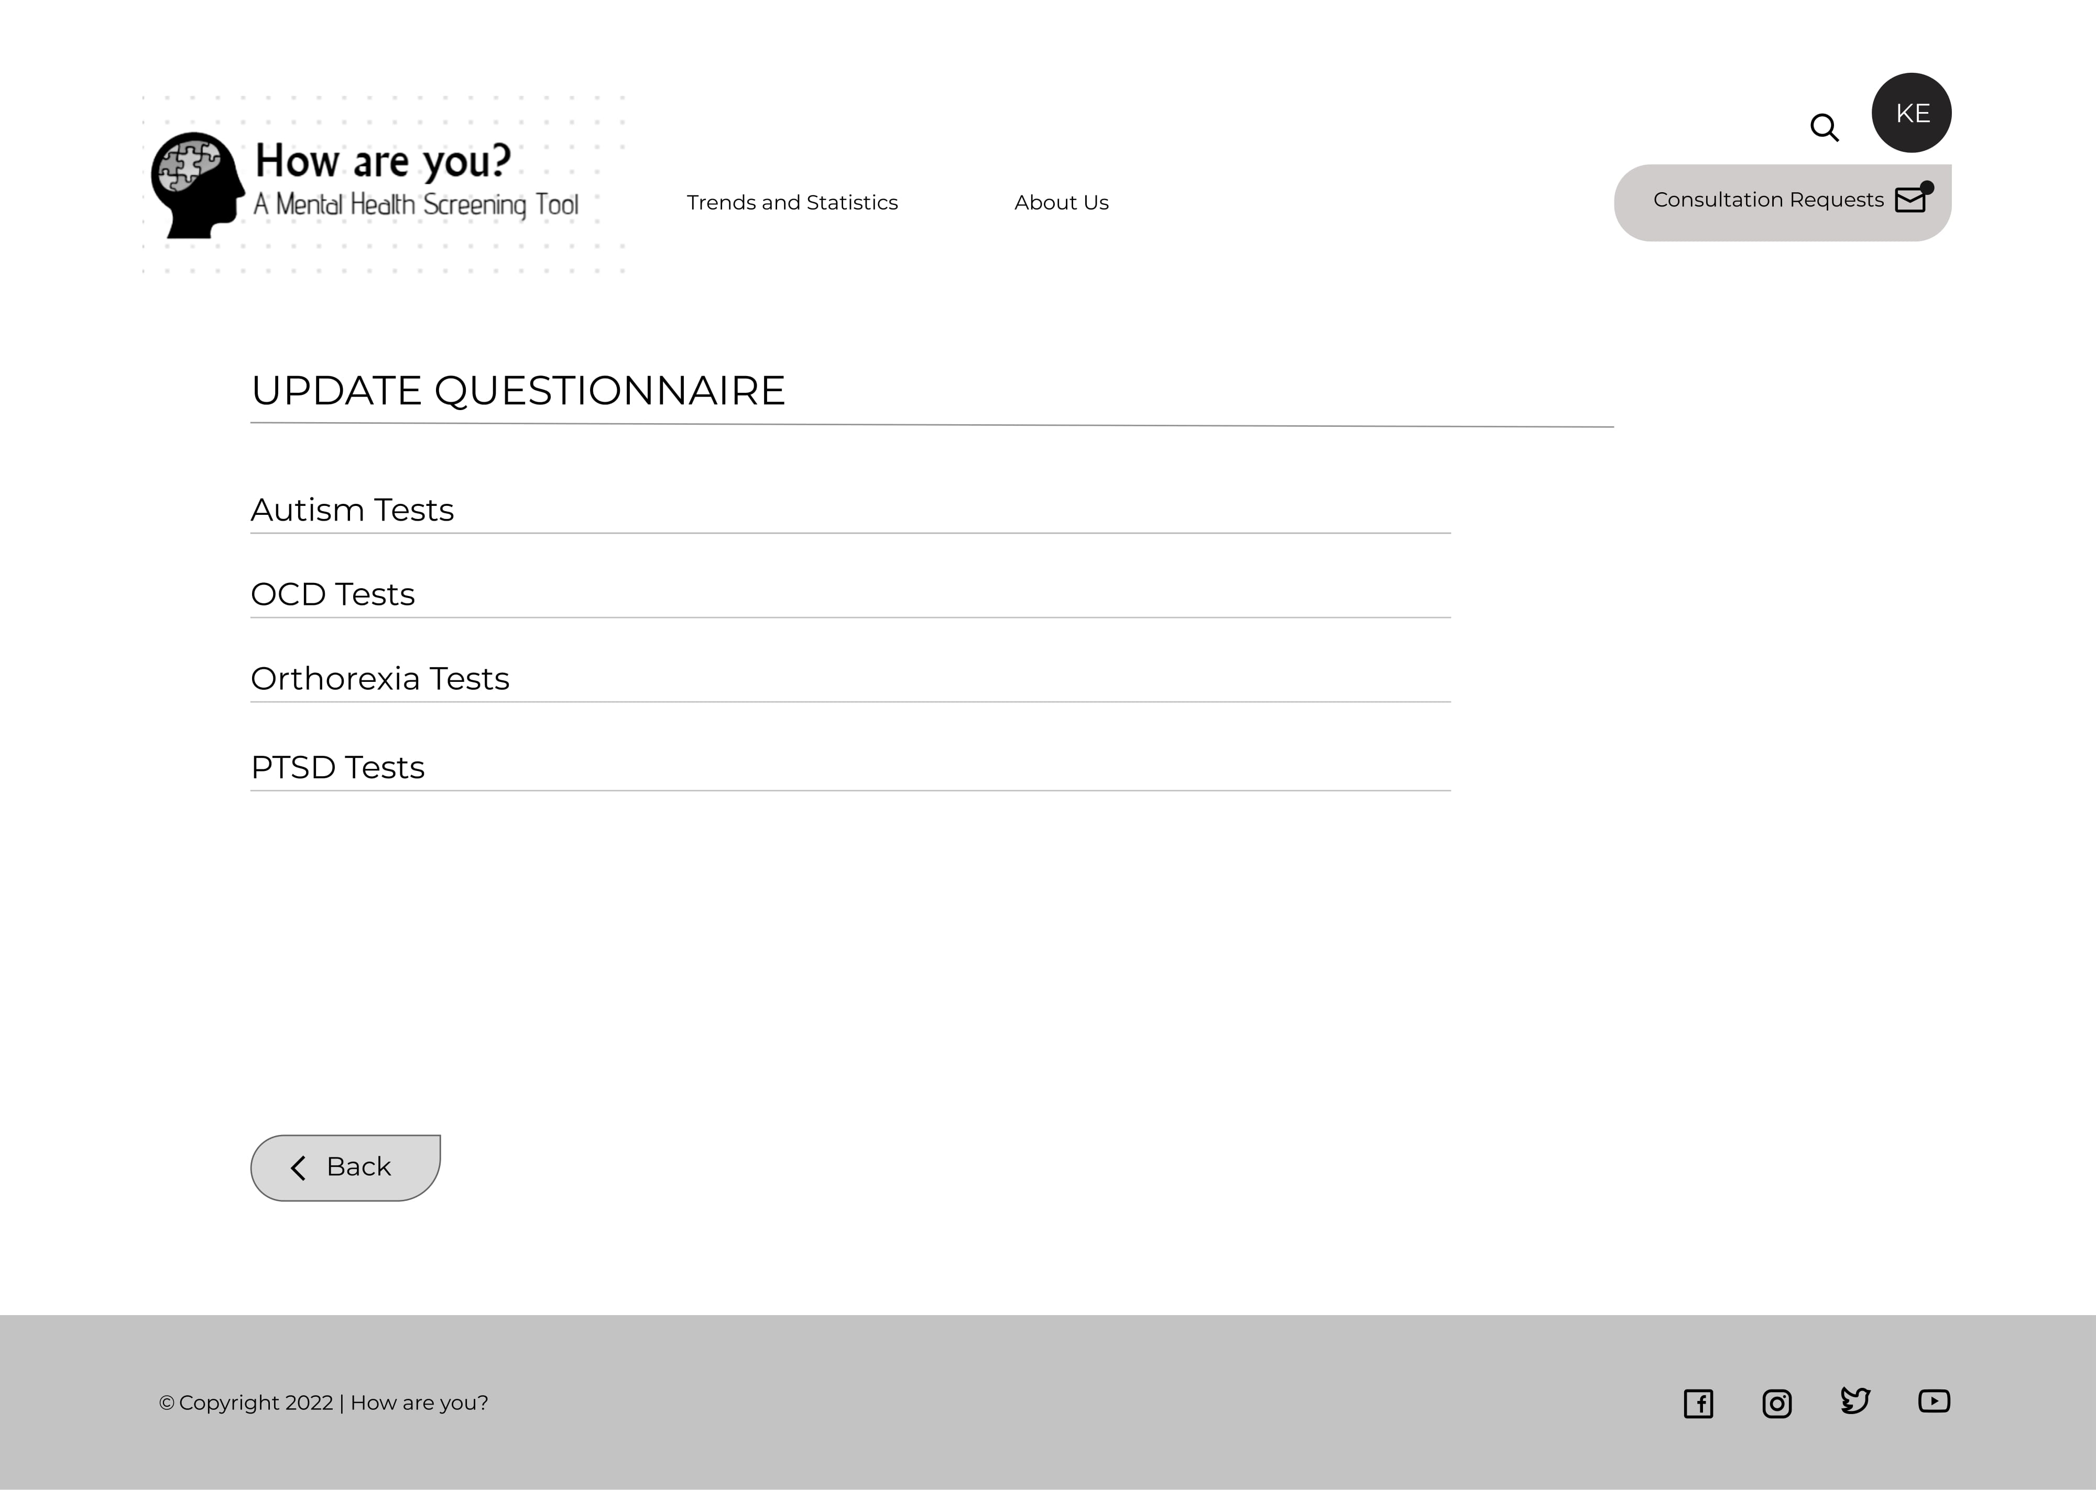

Slide 62
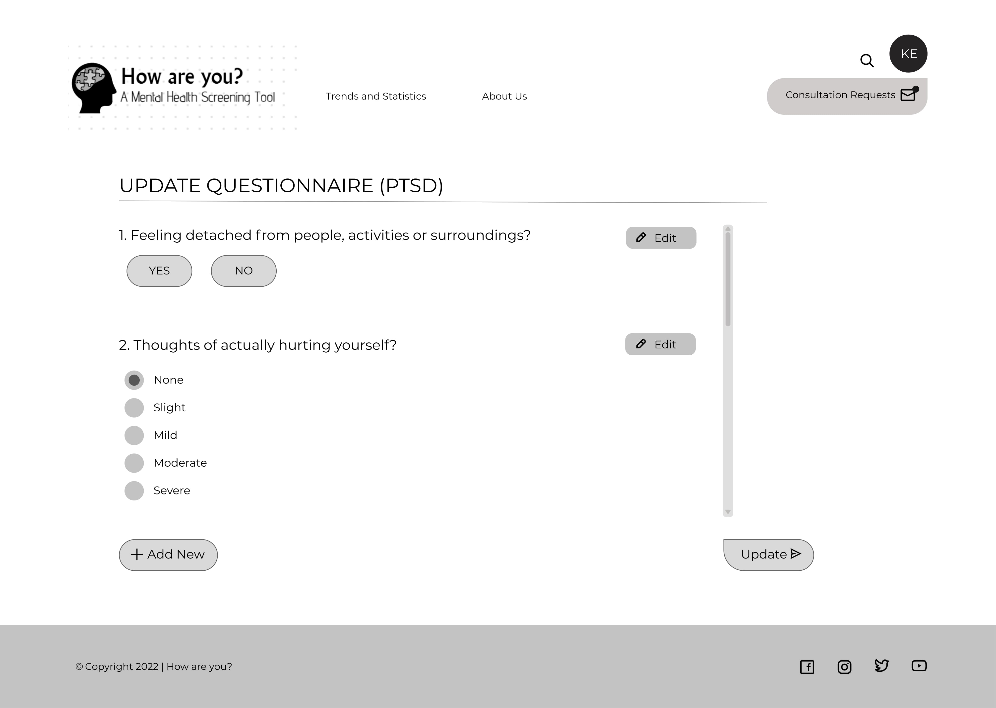

Slide 63
THANK YOU

